Slide 1

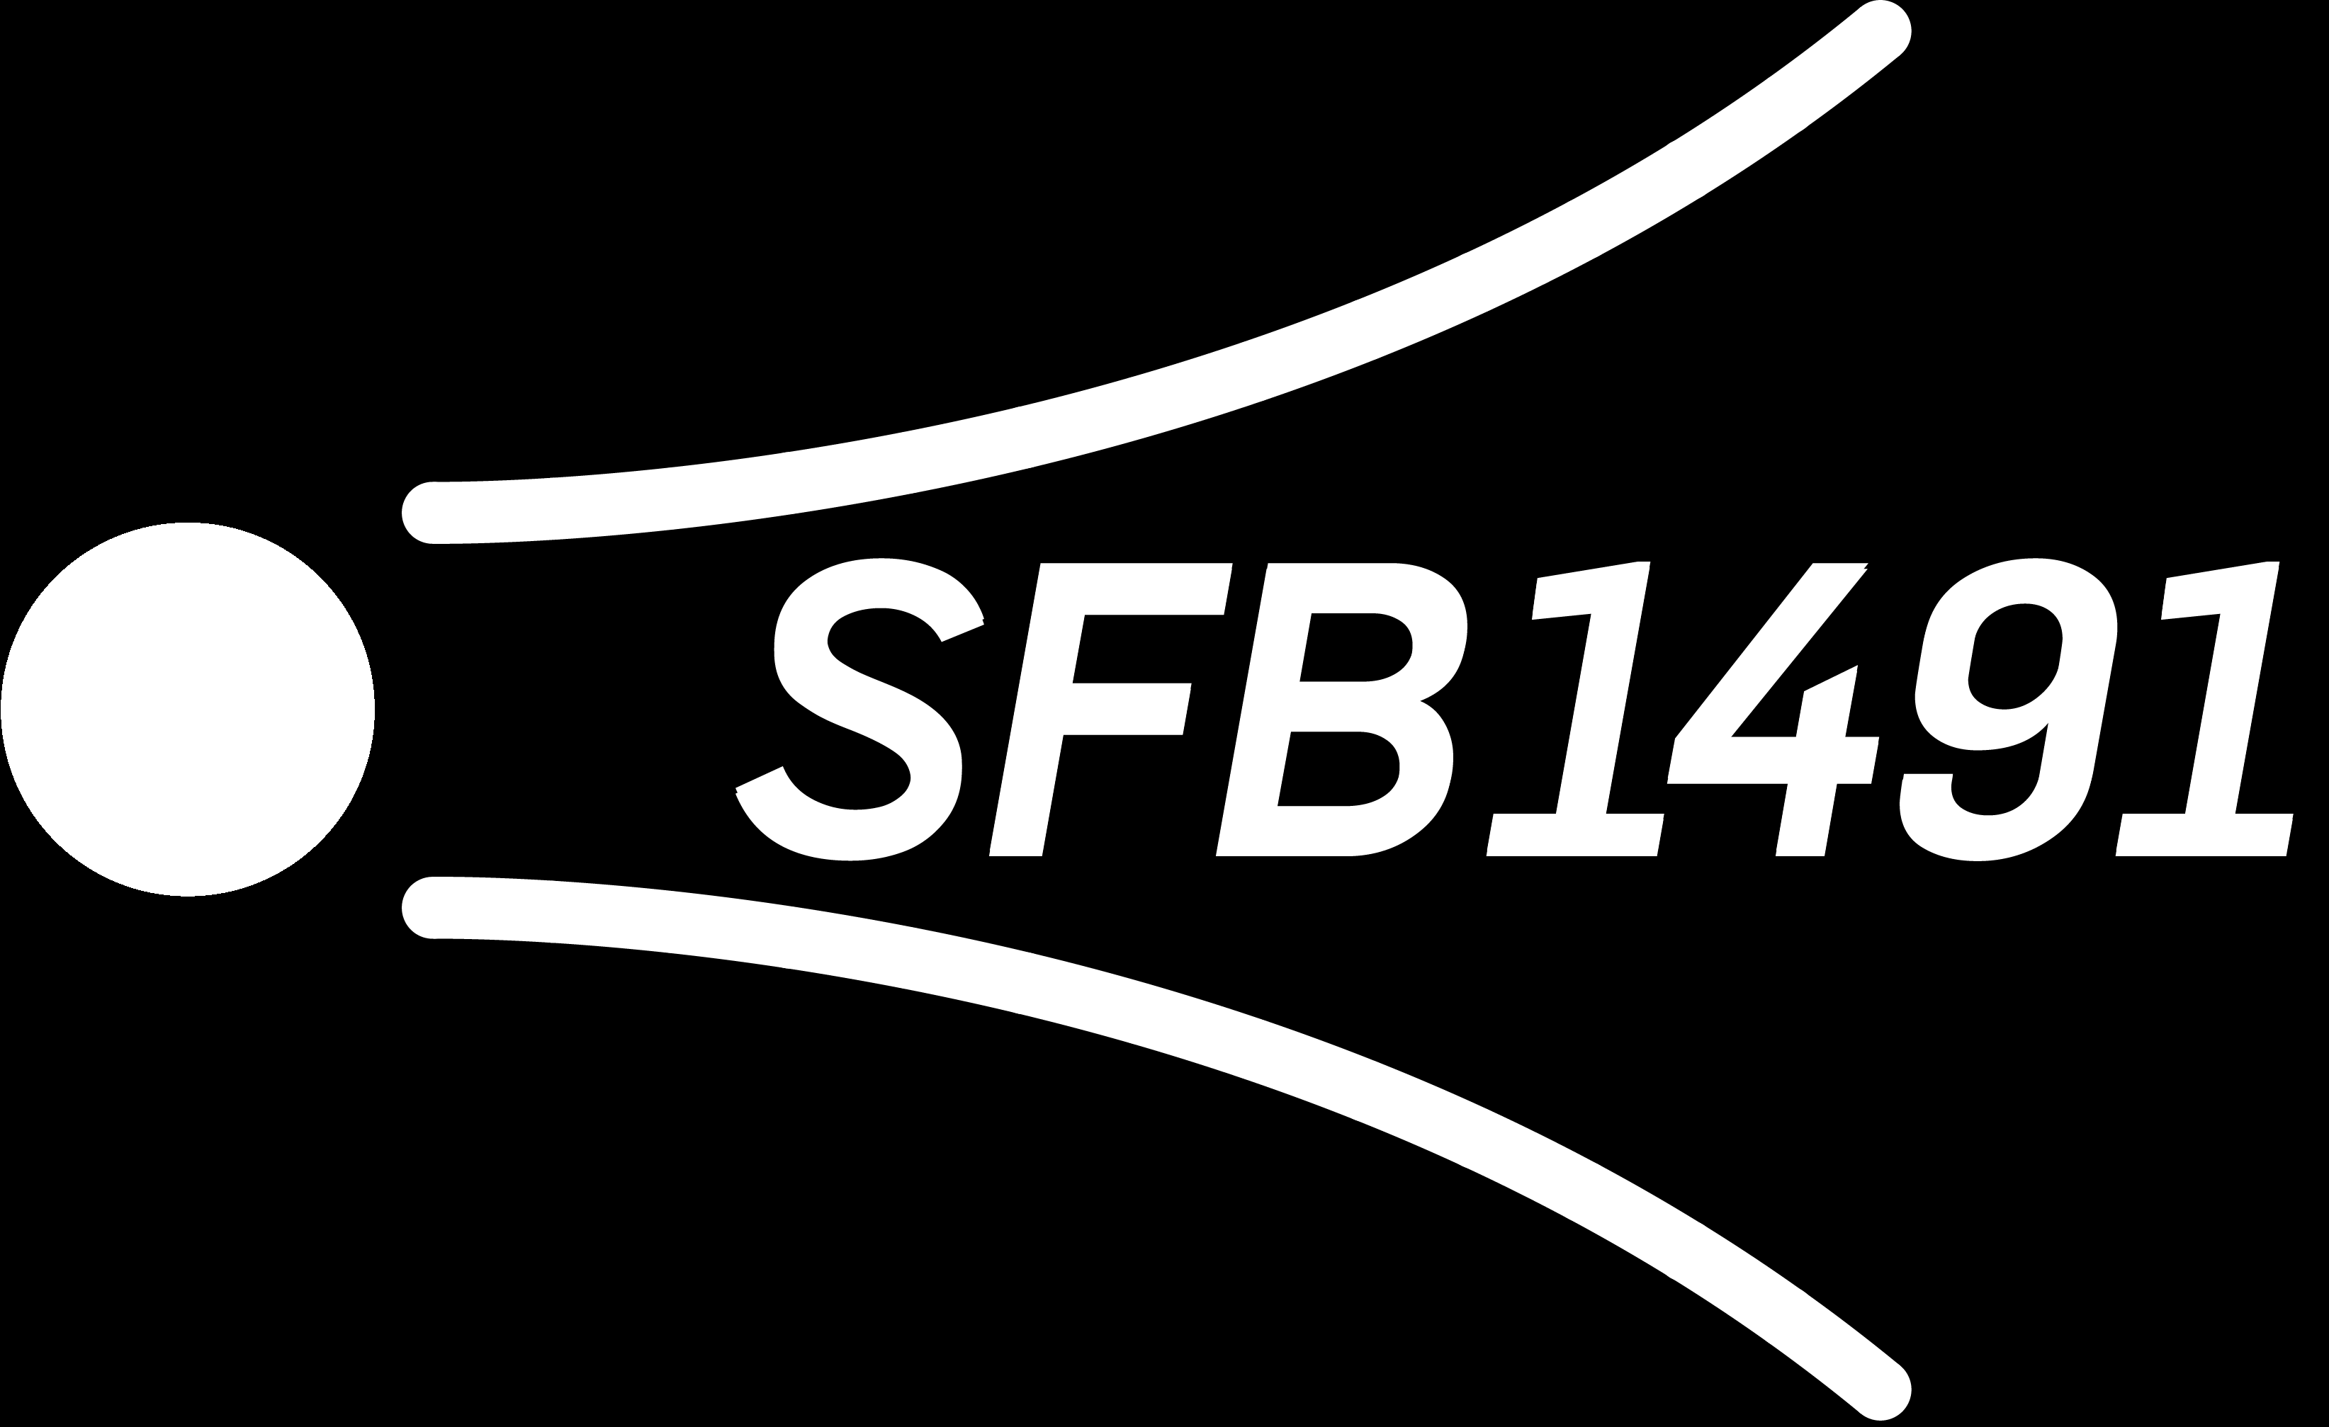
From IceCube to Sky: A Deep Dive into Prompt Muon Mysteries Pascal Gutjahr
September 17, 2024
Source: NASA

Slide 2
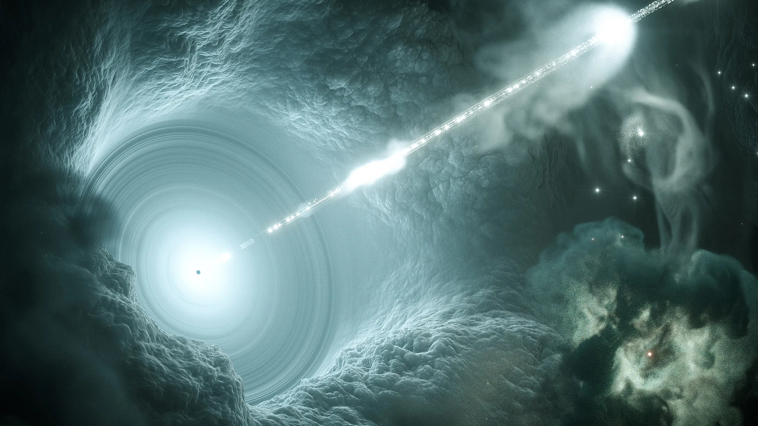

Slide 3

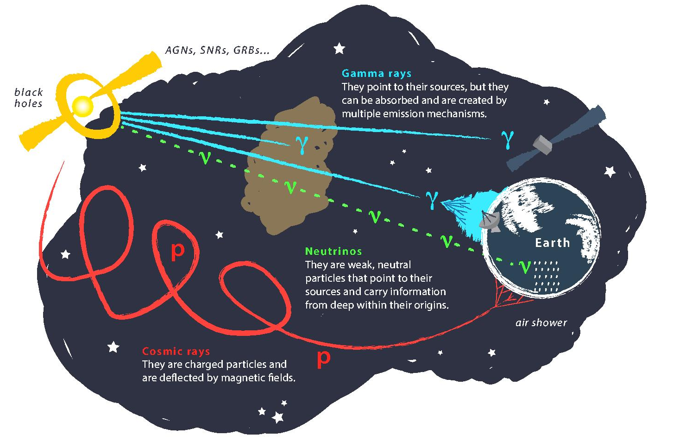
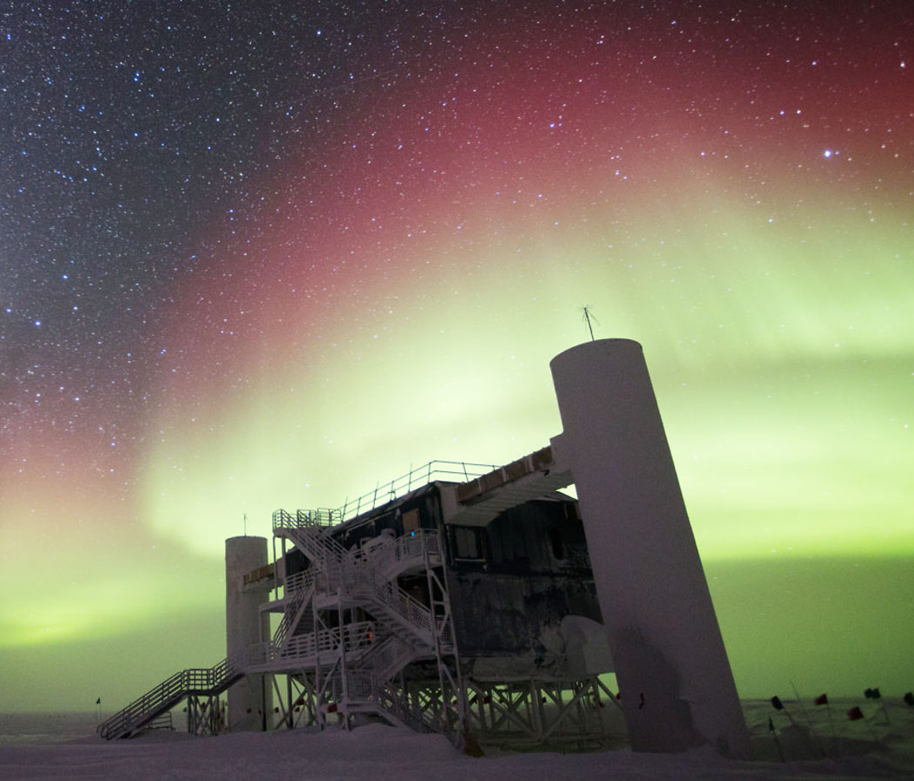
Astroparticle physics
gallery.icecube.wisc.edu
Credit: IceCube / NSF

Slide 4
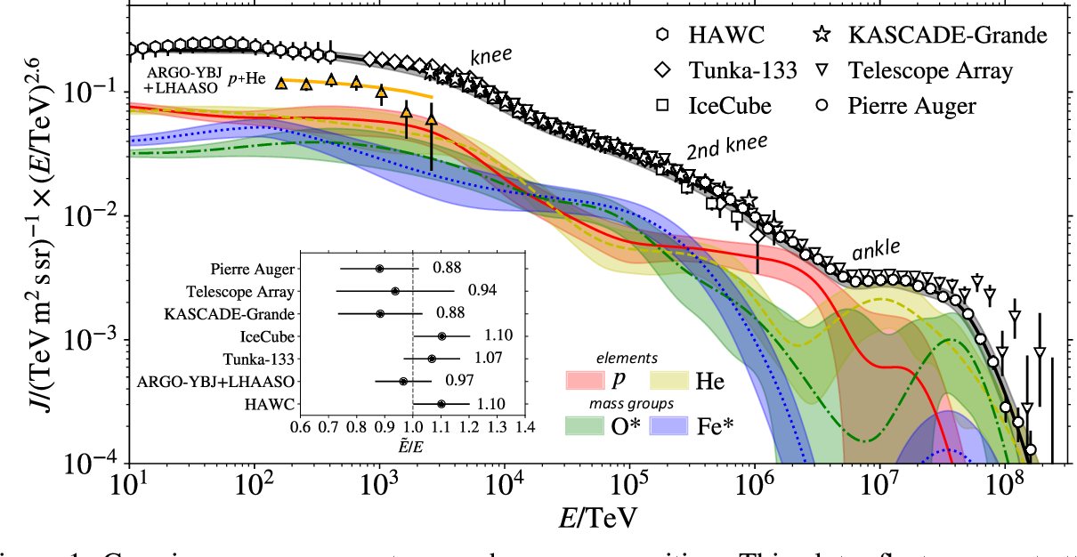
Cosmic ray flux
1903.07713
Notes:
1. Knee: ~3 PeV, before gamma = 2.7, limit of acceleration mechanism for cosmic rays in supernova remnants 2. Knee: ~100 PeV, before gamma = 3.1, heavier elements, like iron, from galactic sources start to reach their maximum acceleration energy → more protons, larger energy in electromagnetic acceleration Ankle: ~1 EeV, flattens out again, transition point between galactic and extra galactic particle origin,

Slide 5
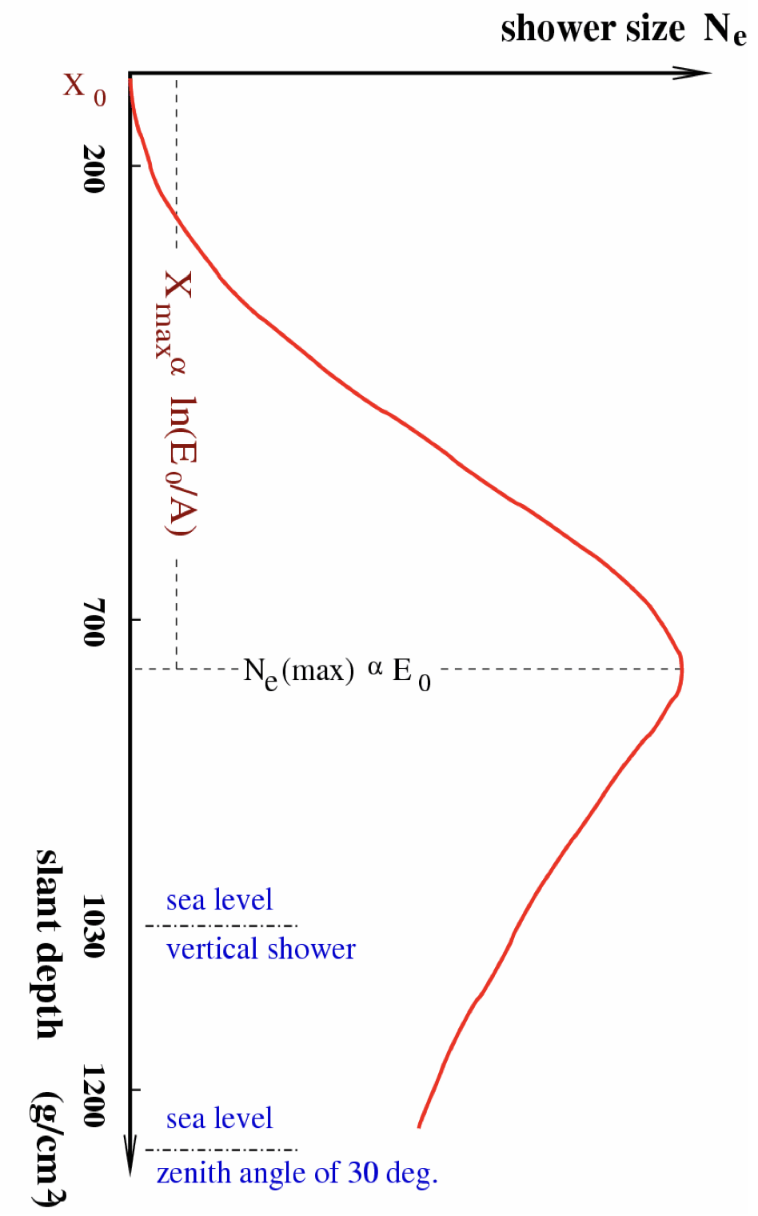
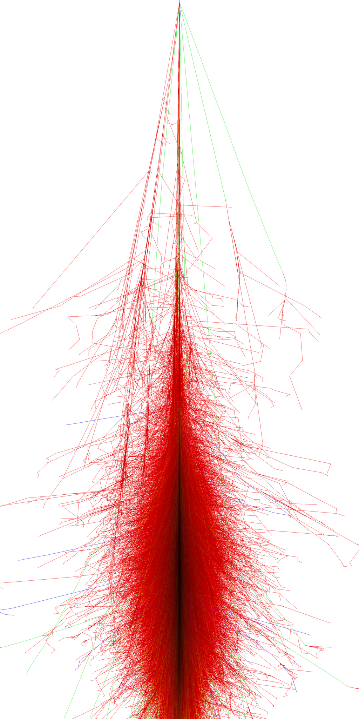
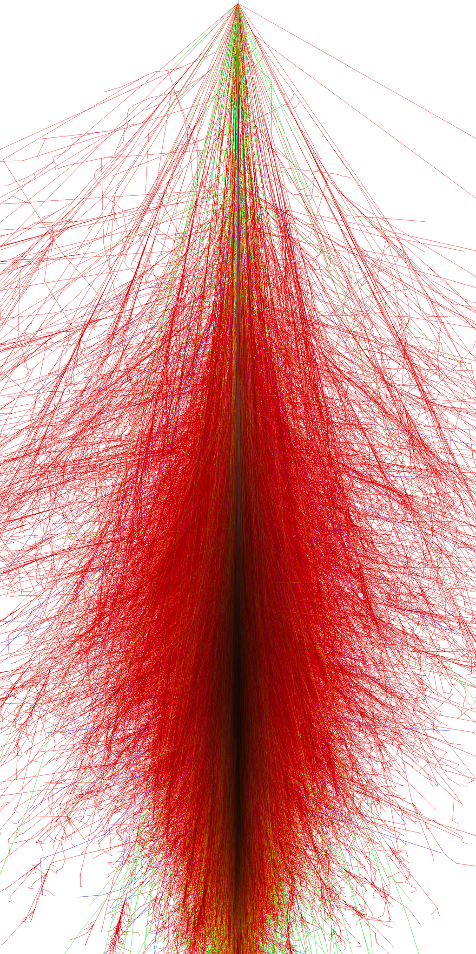
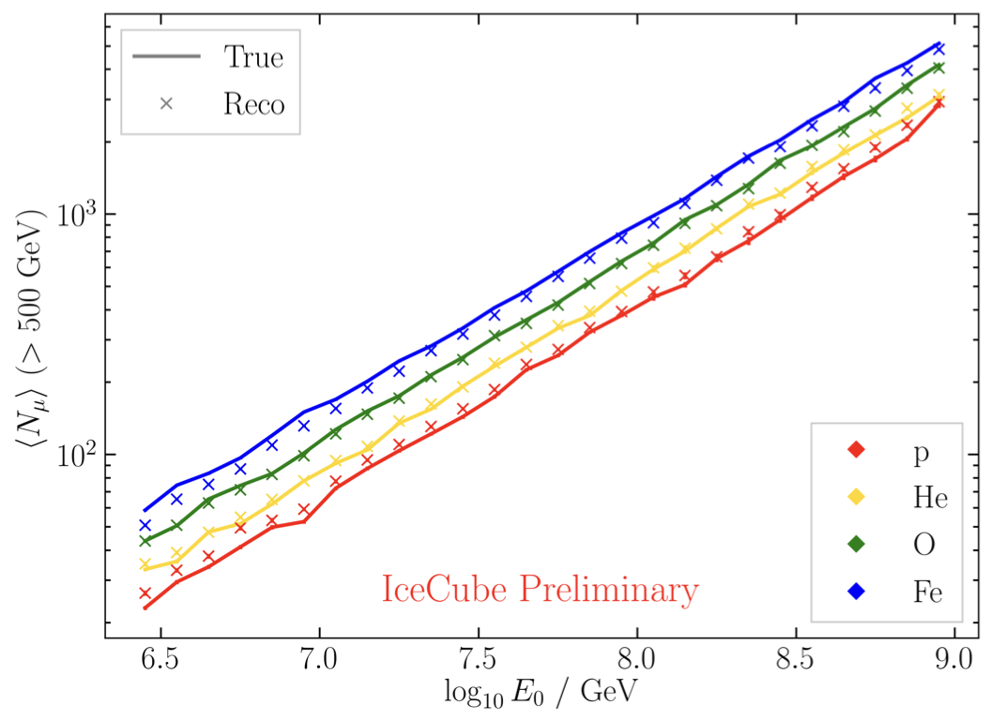
Air shower – 10 TeV
“muon bundles”
zeuthen.desy.de
Ralph Engel 2005
2211.16970v2
Proton
Iron
Notes:
shower maximum: x_max, slant depth at which the number of particles is the greatest, more energetic and lighter cosmic rays produce deeper/lower x_max, while heavier nuclei have a higher shower maximum
measure number of particles / muons
lateral spread
nitrogen can be excited → fluorescence light emitted
iron produces more muons than proton, because it has 56 nucleons → higher fragmentation → “sub-showers”

Slide 6

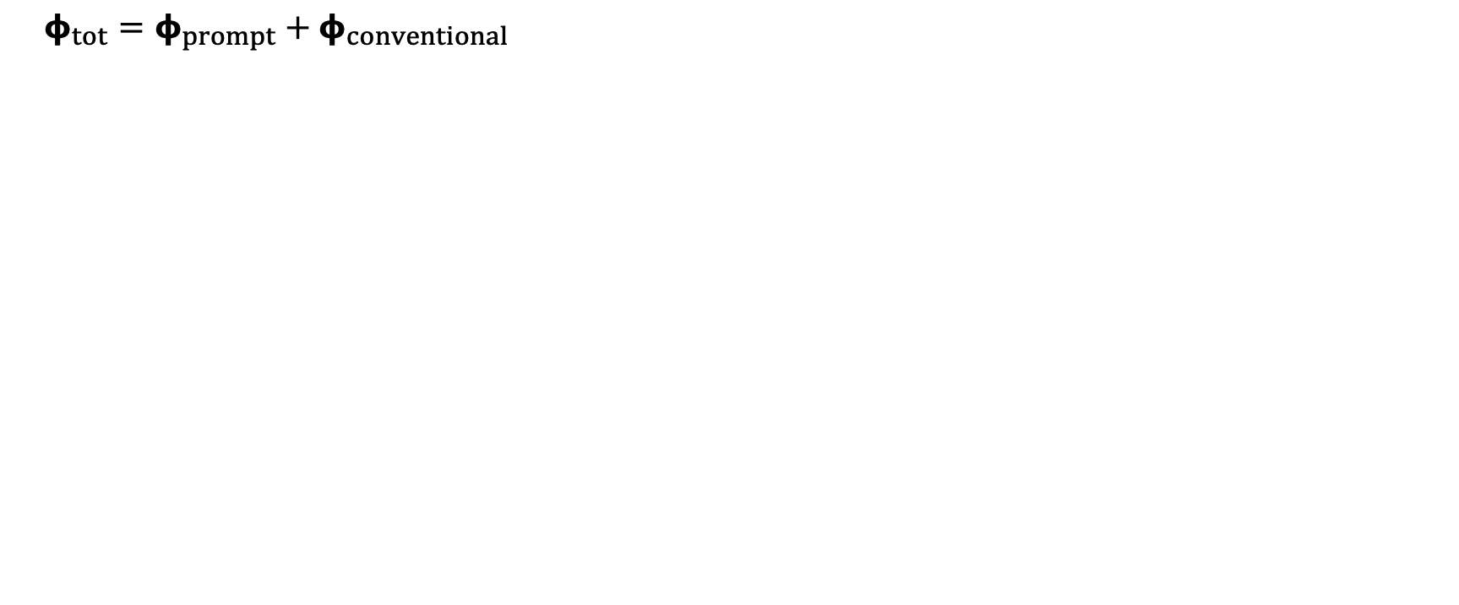
Muon flux
$φ_{tot}=φ_{prompt}+$ $φ_{conventional}$
Credit: Ludwig Neste
Notes:
gamma = 2.7: SNR → fermi/shock acceleration, propagation of cosmic rays lead to interactions with galactic magnetic fields, interactions with gas, energy losses (ionization and nuclear interactions), in this process, some cosmic rays can escape the magnetic fields → this rate is energy dependent → higher-energtic cosmic rays escape more quickly → steepening of spectrum to ~2.7

Slide 7
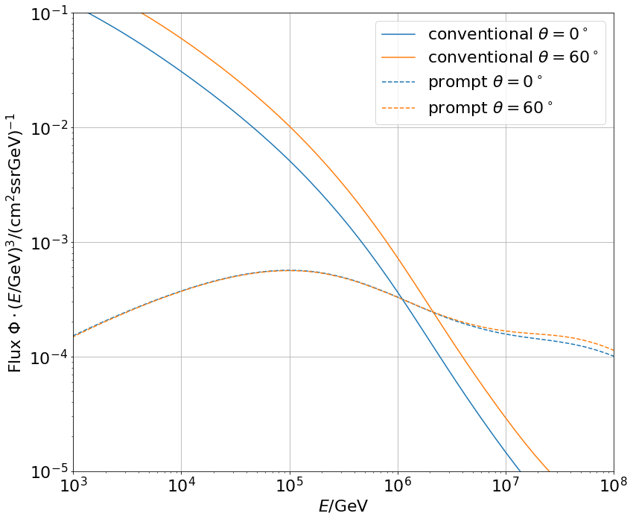
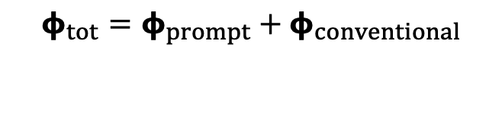
Muon flux: Prompt spectrum
$φ_{tot}=φ_{prompt}+$ $φ_{conventional}$
0°: perpendicular to Earth’s surface
Most energetic muon in bundle
conventional
prompt
Muon parent:
pion or kaon
yes
no
conventional
prompt

Slide 8
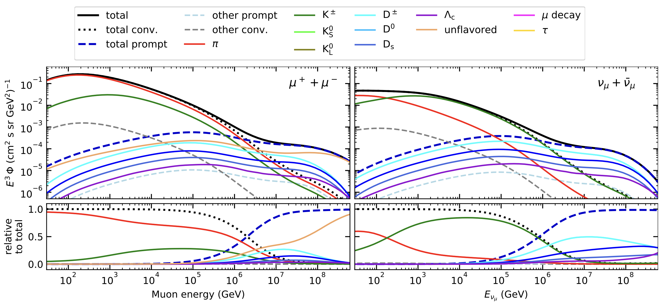
Prompt atmospheric muons and neutrinos
10.1103/PhysRevD.100.103018
no unflavored
dominated by pions
dominated by kaons
Combined fit:
handle on pion/kaon ratio
handle on charmed mesons

Slide 9
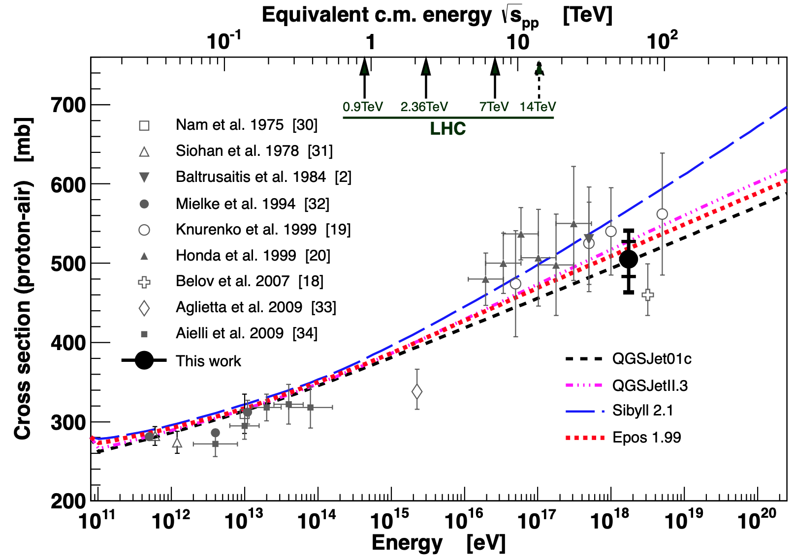
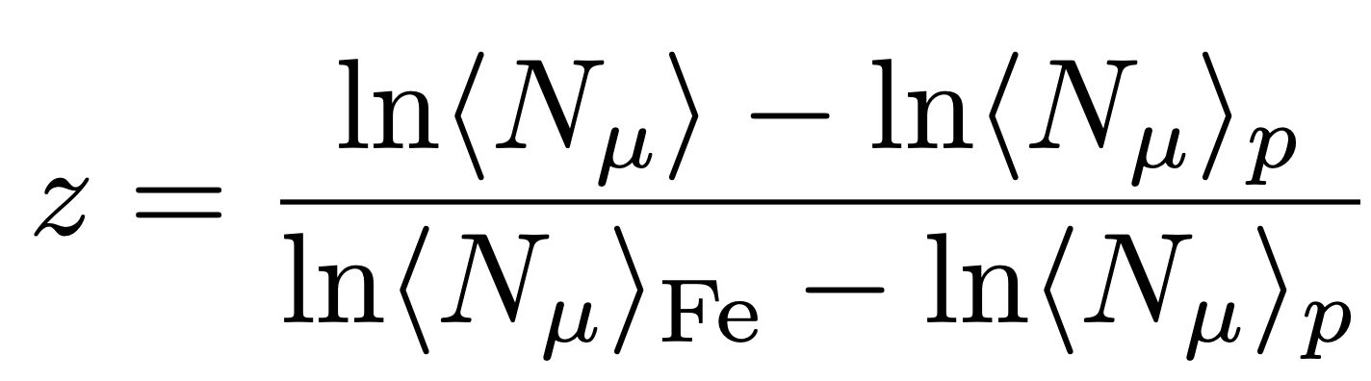
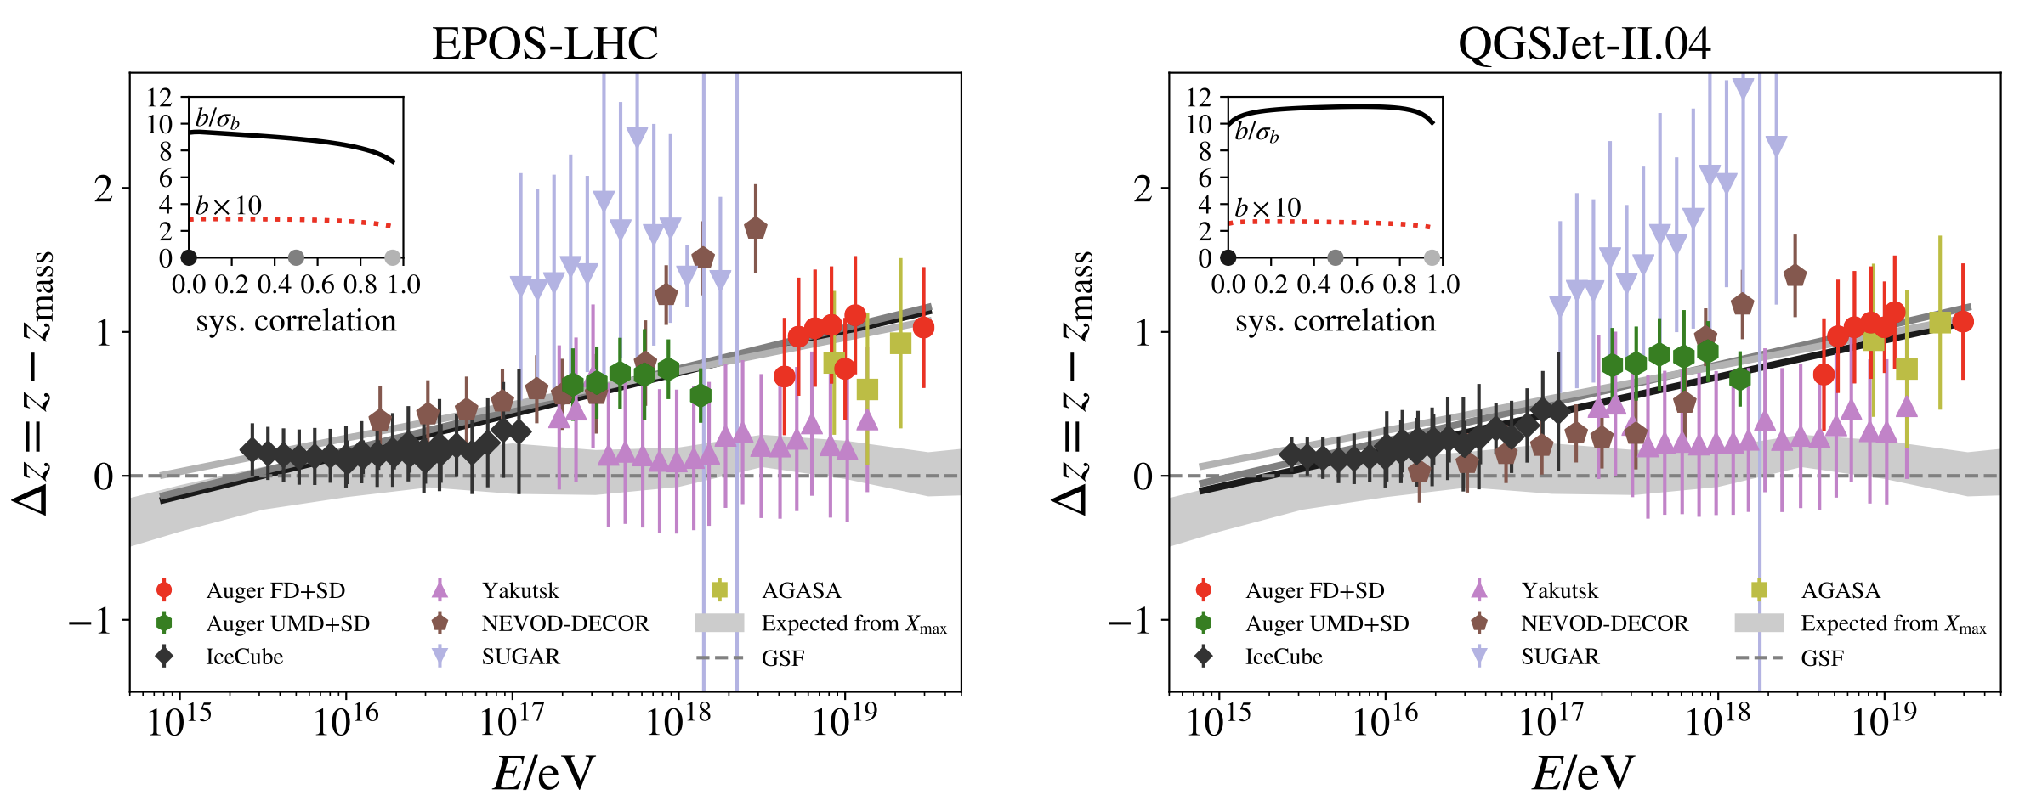
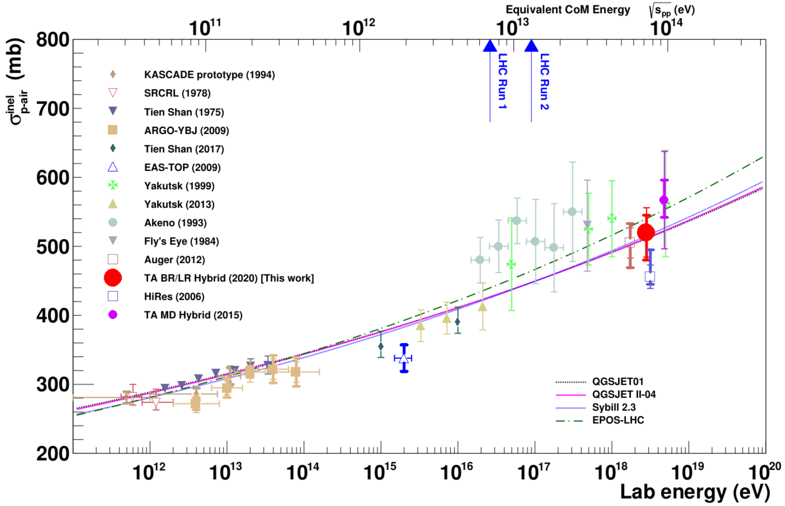
Muon puzzle and model uncertainties
”muon number”
Expected z
(“muon number”)
2012
2108.08341
1208.1520
Uncertainties at E > 10 PeV
2020
More muons measured than simulated for E > 40 PeV ~ cms 8 TeV
2006.05012

Slide 10
Analysis goals
Detect prompt component of the atmospheric muon flux
Measure the normalization
Get handle on hadronic interaction models
Unfold a muon energy spectrum
Idea:
New CORSIKA simulations with extended history
Tag muons by parent → prompt or conventional
Scale amount of prompt particles
Scaling saves time and resources instead of doing multiple simulations with different interaction models
Perform forward fit of the prompt normalization
Future:
Measure prompt neutrinos
Combined muon and neutrino fit → pion/kaon ratio

Slide 11
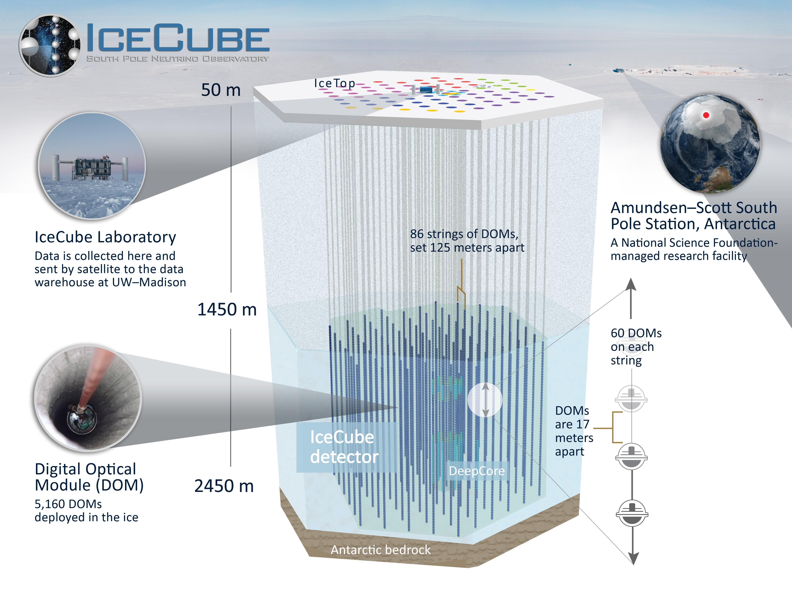

Slide 12
Overview
Analysis
Simulation
Reconstruction
Selection
Forward fit
Dataset
CORSIKA 77500 Ehist
SIBYLL 2.3d
10 TeV – 100 EeV
DNN reconstructions
Muon energies
Muon direction
Track geometry
Level 3
L2 muon filter
500 TeV bundle energy cut at surface
Add labels
Fit prompt normalization
Poisson LLH fit
Validation
Tag prompt / conv particles
MCEq comparisons
Unfolding
Level 4
Add DNN reconstructions
Muon spectrum
Unfold muon flux
Level 5
Data-MC quality cuts

Slide 13
New CORSIKA simulation
with extended history option for information about the parent particles

Slide 14
CORSIKA 7 tagging and MCEq comparison
MCEq: tool to numerically solve the cascade equations that describes the evolution of particle densities as they propagate through a gaseous, dense medium
https://github.com/mceq-project/MCEq
GSF weighting
GSF weighting
Good agreement in total prompt and conv muon flux
D⁰ and D_{s} are swapped here but this is fixed in MCEq

Slide 15
Agreement for different primary models

Slide 16
DNN reconstructions

Slide 17
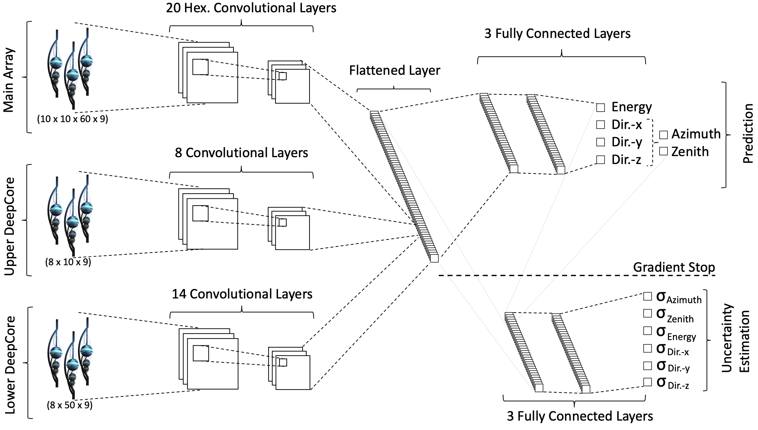
Convolutional Neural Network (CNN)
Machine learning approach:
fast
identifying spatial patterns
better event reconstruction and classification
2101.11589

Slide 18
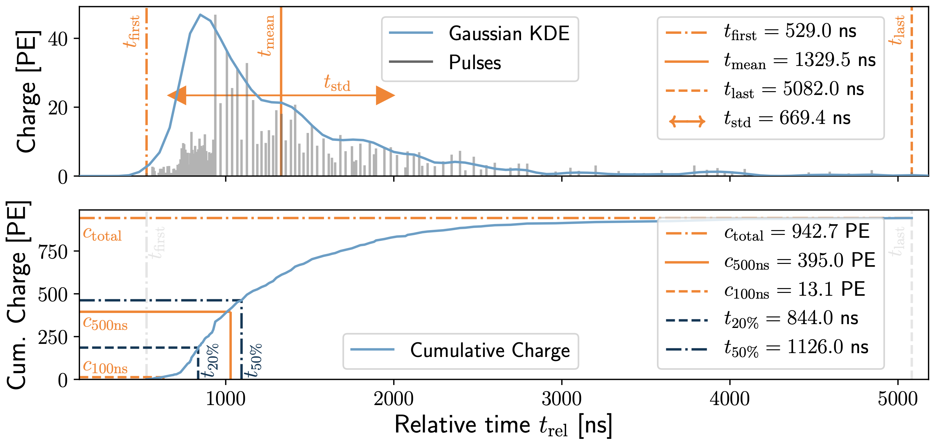
Input data per DOM
10.1088/1748-0221/16/07/P07041
3 inputs
c_{total}: Total charge
Sum of charge
t_{first}: Relative time of first pulse
Relative to total time offset, calculated as the charge weighted mean time of all pulses
t_{std}: Standard deviation of first pulse
Charge weighted standard deviation of pulse times relative to total time offset
9 inputs
t_{last}: Relative time of last pulse
Relative to total time offset, calculated as the charge weighted mean time of all pulses
t_{20%}: Relative time of 20% charge
Relative to total time offset, calculated as the charge weighted mean time of all pulses
t_{50%}: Relative time of 50% charge
Relative to total time offset, calculated as the charge weighted mean time of all pulses
t_{mean}: Mean time
Charge weighted mean time of all pulses relative to total time offset
c_{500ns}: Charge at 500ns
Sum of charge after 500ns
c_{100ns}: Charge at 100ns
Sum of charge after 100ns
Input pulses
SplitInIceDSTPulses
SplitInIceDSTPulsesTWCleaning6000ns
(DNN framework performs an internal cleaning)
Training datasets
20904
21962
22020
22187

Slide 19
Reconstructed properties
Energy
entry_energy: Leading muon energy at the detector entry
bundle_energy_at_entry: Muon bundle energy at the detector entry
muon_energy_first_mctree: Leading muon energy at surface
bundle_energy_in_mctree: Muon bundle energy at surface
Track geometry
Length: Propagation length of muon in the ice
LengthInDetector: Propagation length of muon in the detector
center_pos_x: Closest x position of muon to center of the detector
center_pos_y: Closest y position of muon to center of the detector
center_pos_z: Closest z position of muon to center of the detector
center_pos_t: Time of closest approach to the center of the detector
entry_pos_x: x position of muon at the detector entry
entry_pos_y: y position of muon at the detector entry
entry_pos_z: z position of muon at the detector entry
entry_pos_t: Time of muon at the detector entry
Direction
zenith: Zenith angle of muon
azimuth: Azimuth angle of muon
Network 1
Network 0: Muon bundle energy at surface (fast pre-cut)
Network 2
Network 3

Slide 20
Bundle energy at entry – 6 µs cleaned pulses
Median + 90% quantile
Prediction
True

Slide 21
Leading muon energy at entry – 6 µs cleaned pulses
Median + 90% quantile
Prediction
True

Slide 22
Bundle energy at surface – 6 µs cleaned pulses
Median + 90% quantile
Prediction
True

Slide 23
Leading muon energy at surface – 6 µs cleaned pulses
Median + 90% quantile
Prediction
True

Slide 24
Angular reconstructions: DNN vs. SplineMPE
DNN contours
DNN: ~6ms
Only small improvement at energies around 1 PeV
Countours are larger
Additional runtime
-> Use only DNN reconstruction, since we do not need the best angular resolution
Notes:
angular resolution: opening angle between true and reconstructed

Slide 25
Selection

Slide 26
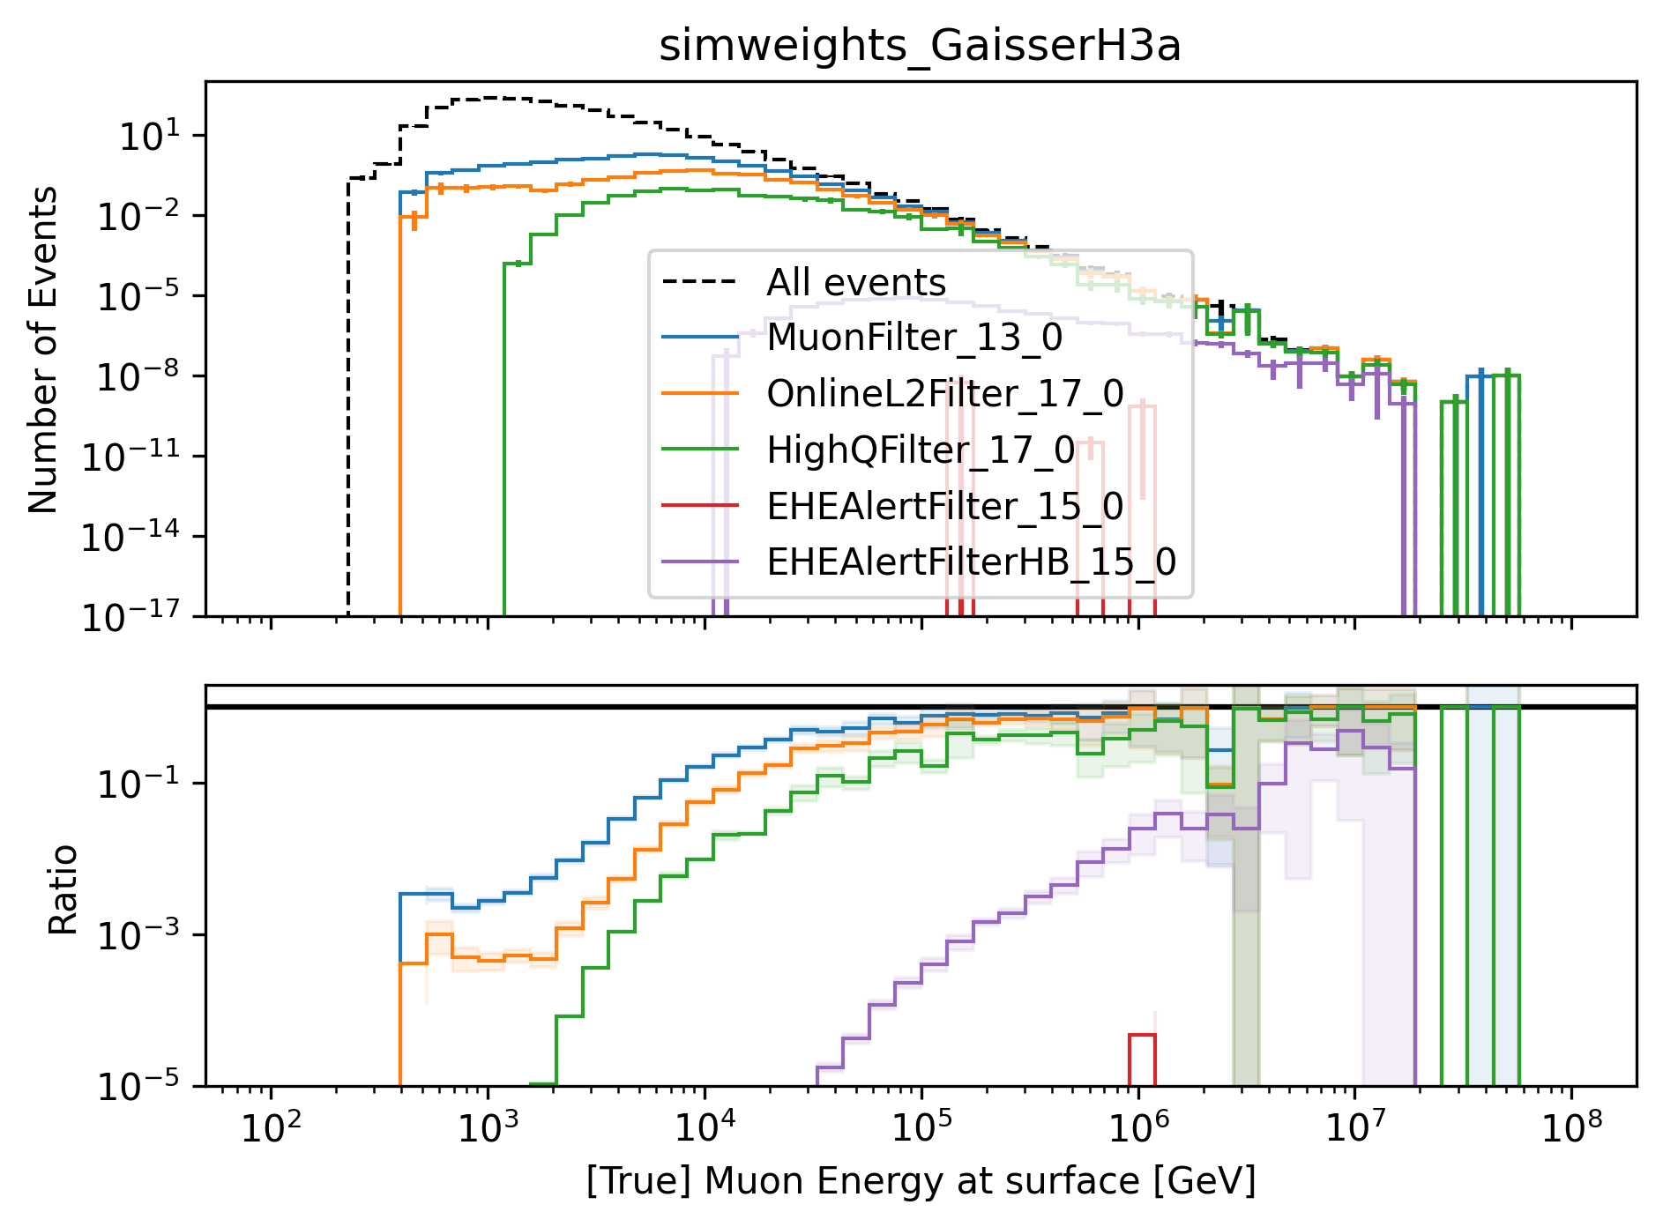
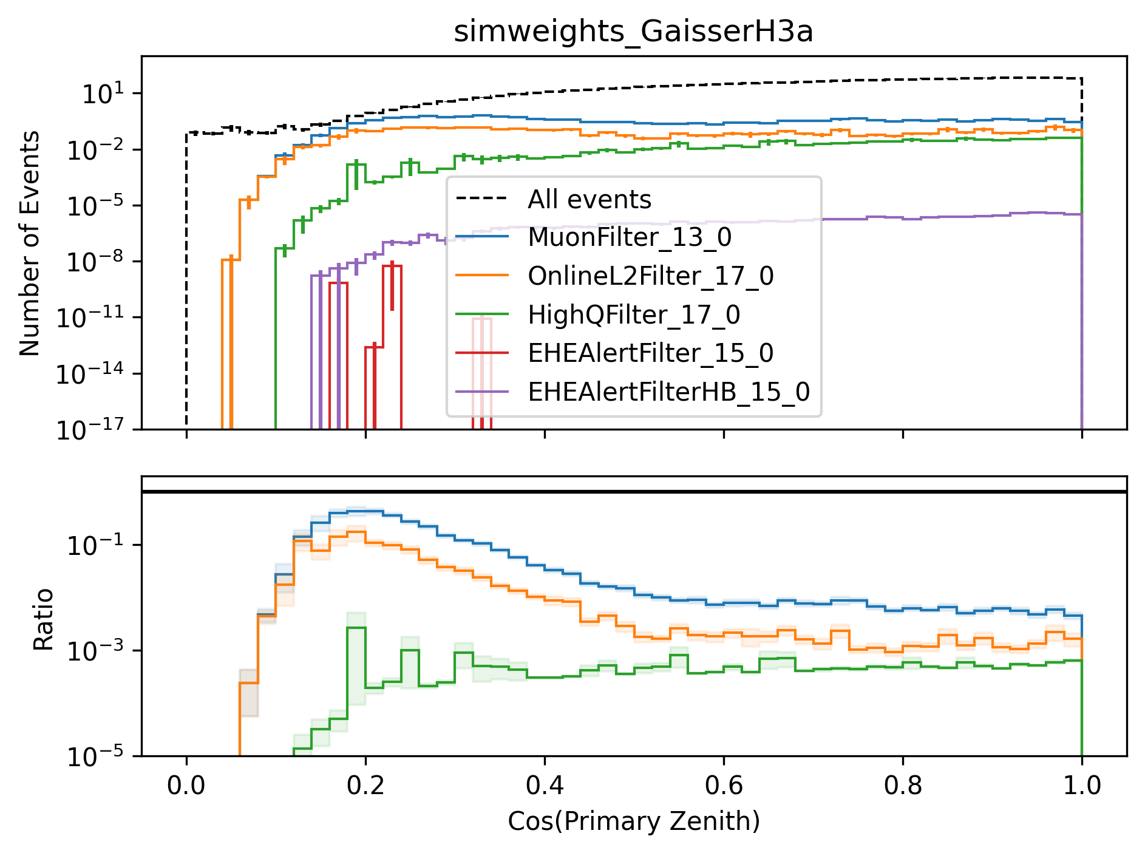
level3: muon filter
HighQFilter: removes more horizontal events → muons travel large distances, not enough energy left to pass high-charge filter
Goal: keep AMAP high-energy events at surface → muon filter
Notes:
muon filter checks for number of hit channels and charge for 3 different zones onlineL2filter also checks for hit channels, charge and 3 zones, but also a couple of more properties like multiplicity, direct hits and specific shapes in the Qtot distribution (kinks, slope)

Slide 27
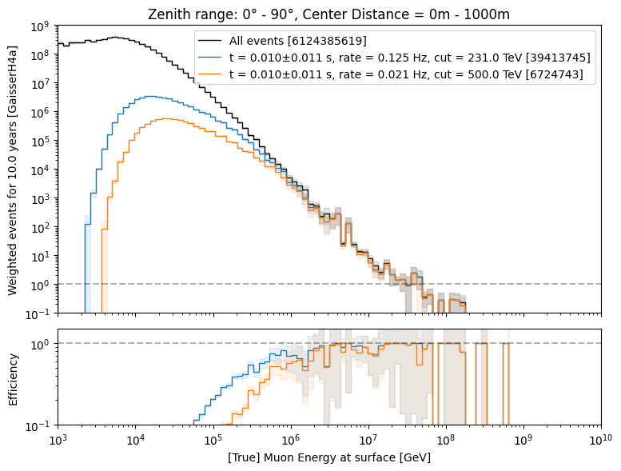
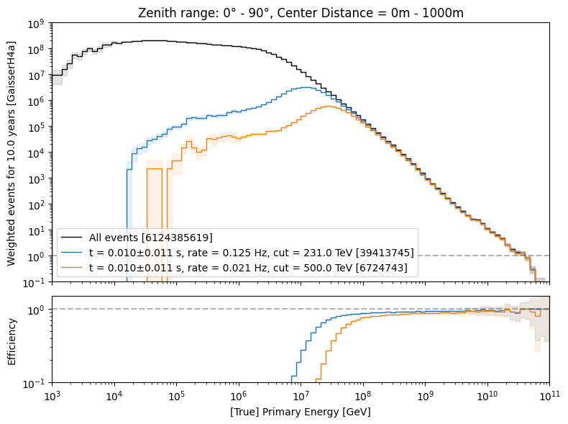
level3: 500 TeV bundle cut at surface
6 billion events expected: computationally not feasible → focus on high-energetic events
500 TeV cut: 6.7 Mio events left
use fast pre-cut network to estimate bundle energy at surface

Slide 28
level4: add dnn reconstructions
Network 1: Energy
Network 2: Track geometry
Network 3: Direction

Slide 29
Data-MC

Slide 30
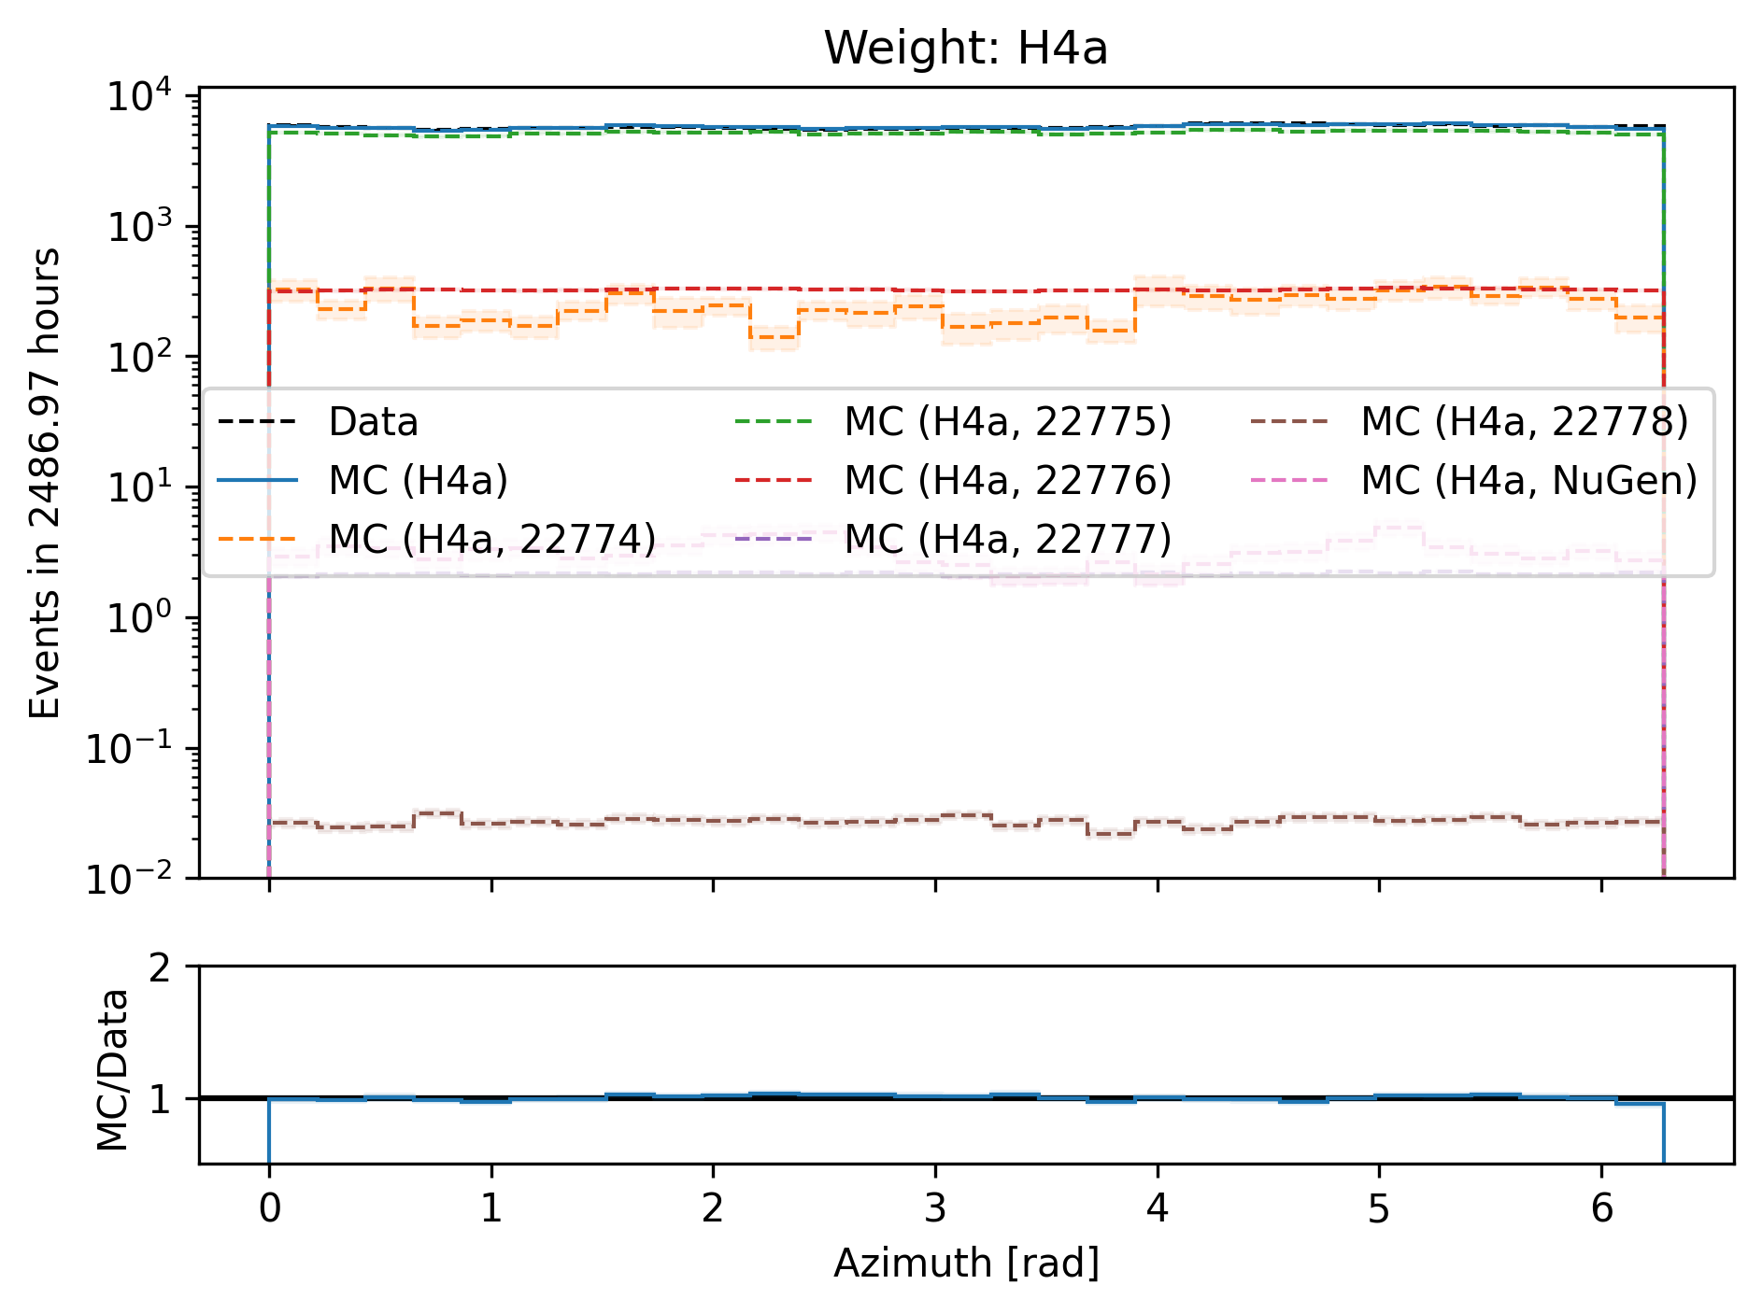
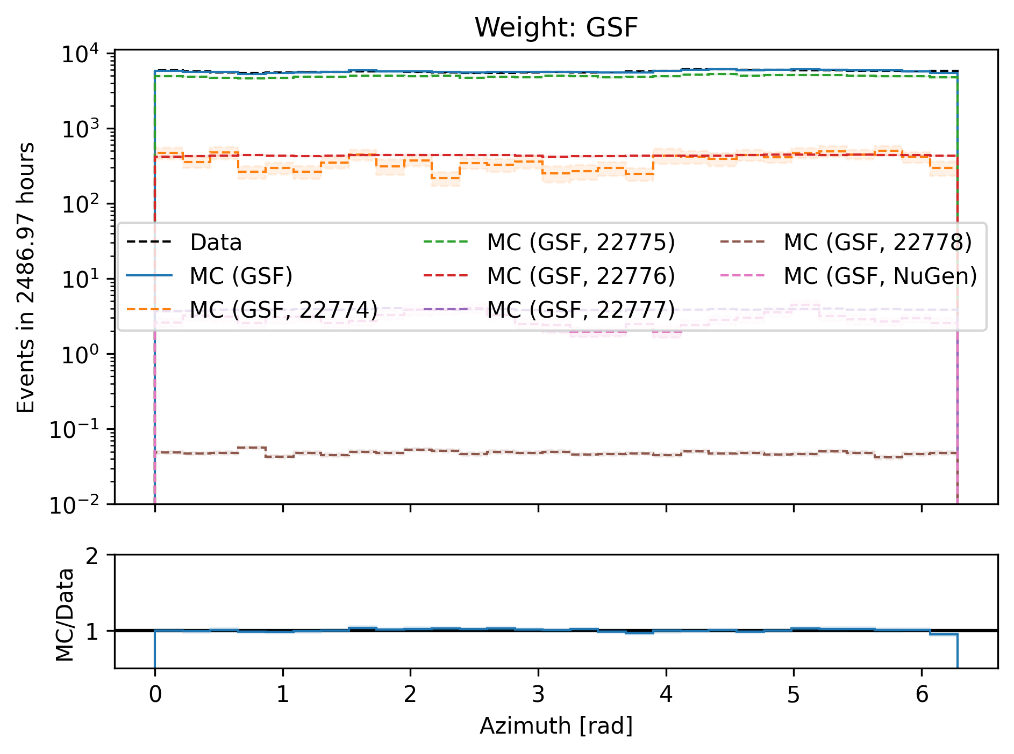
Azimuth

Slide 31
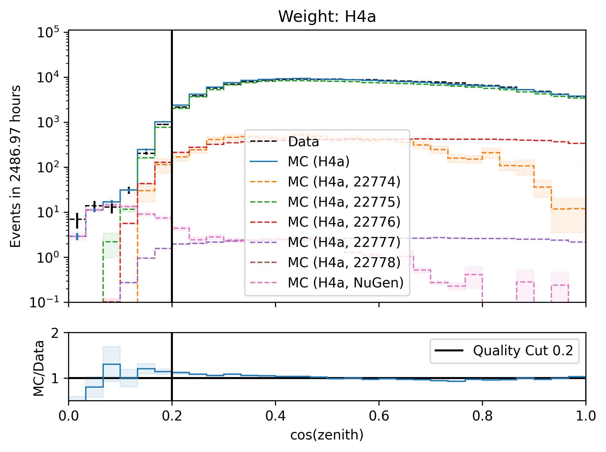
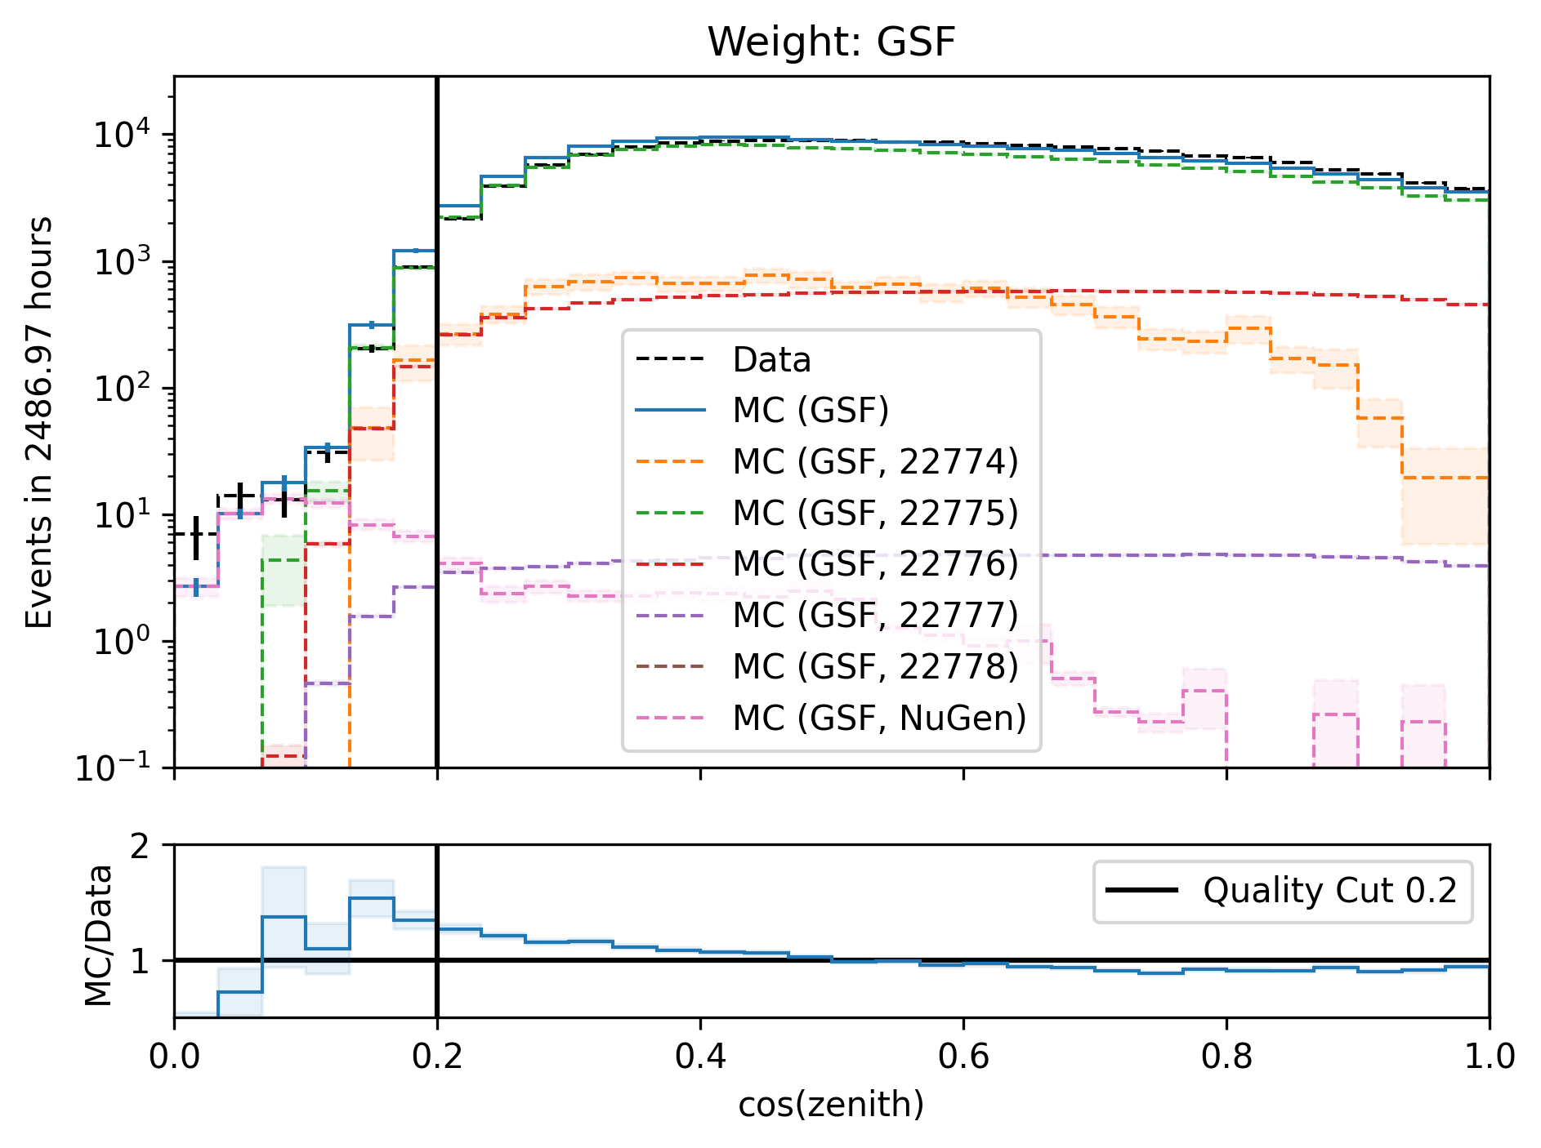
Cos(zenith)

Slide 32
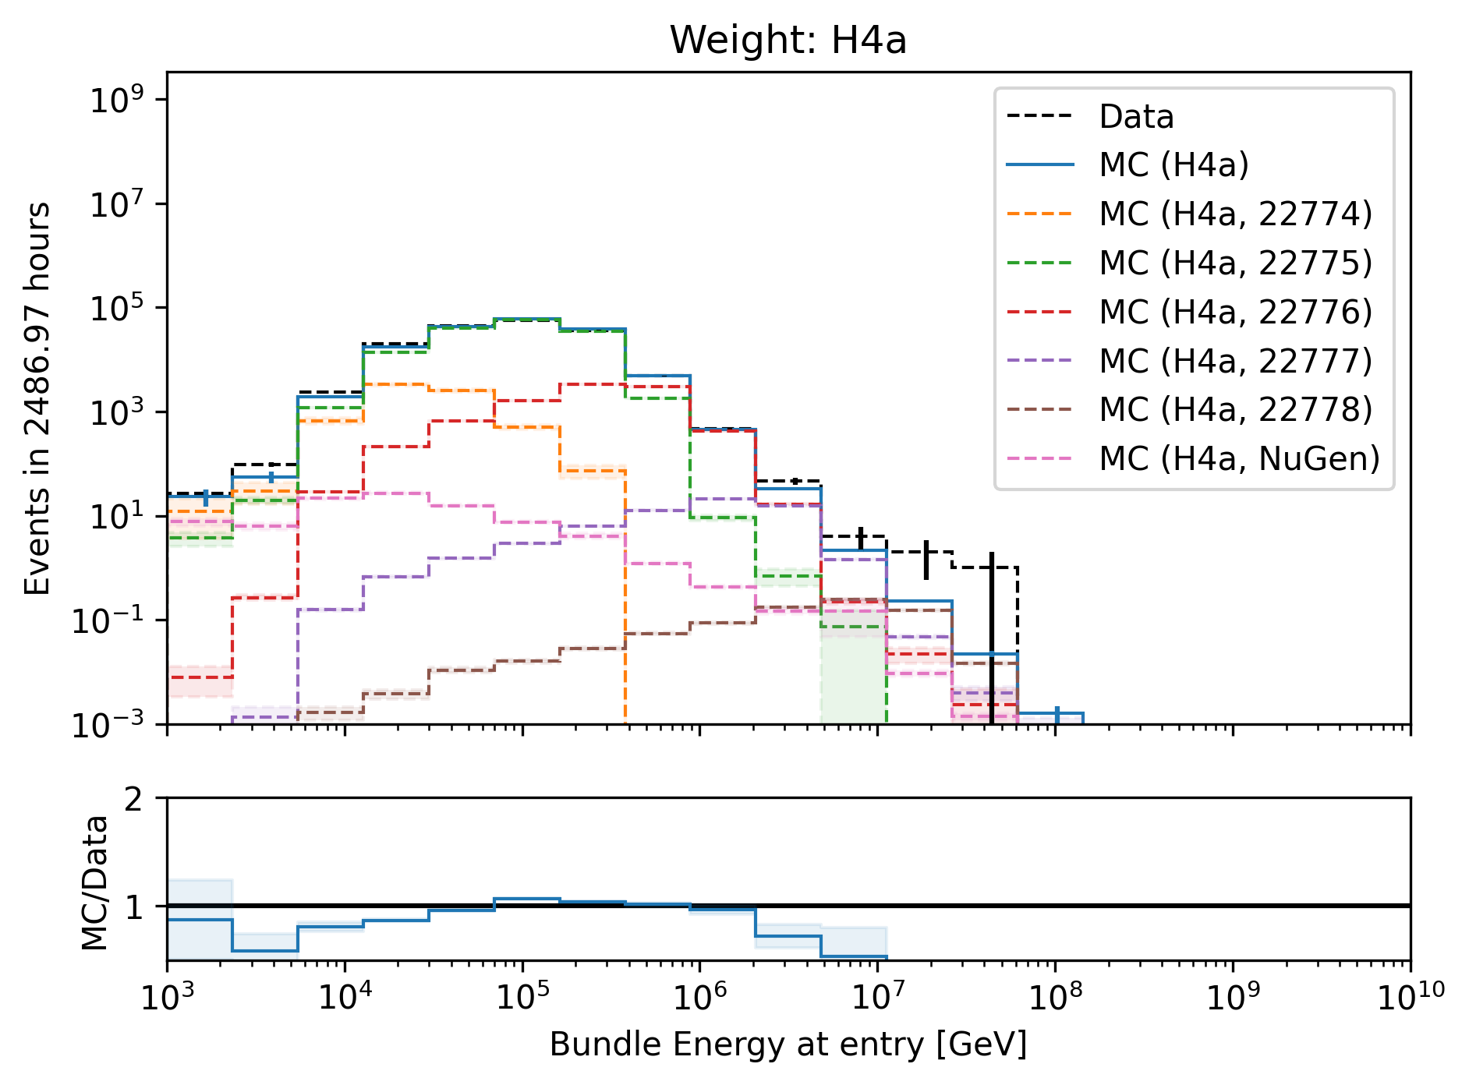
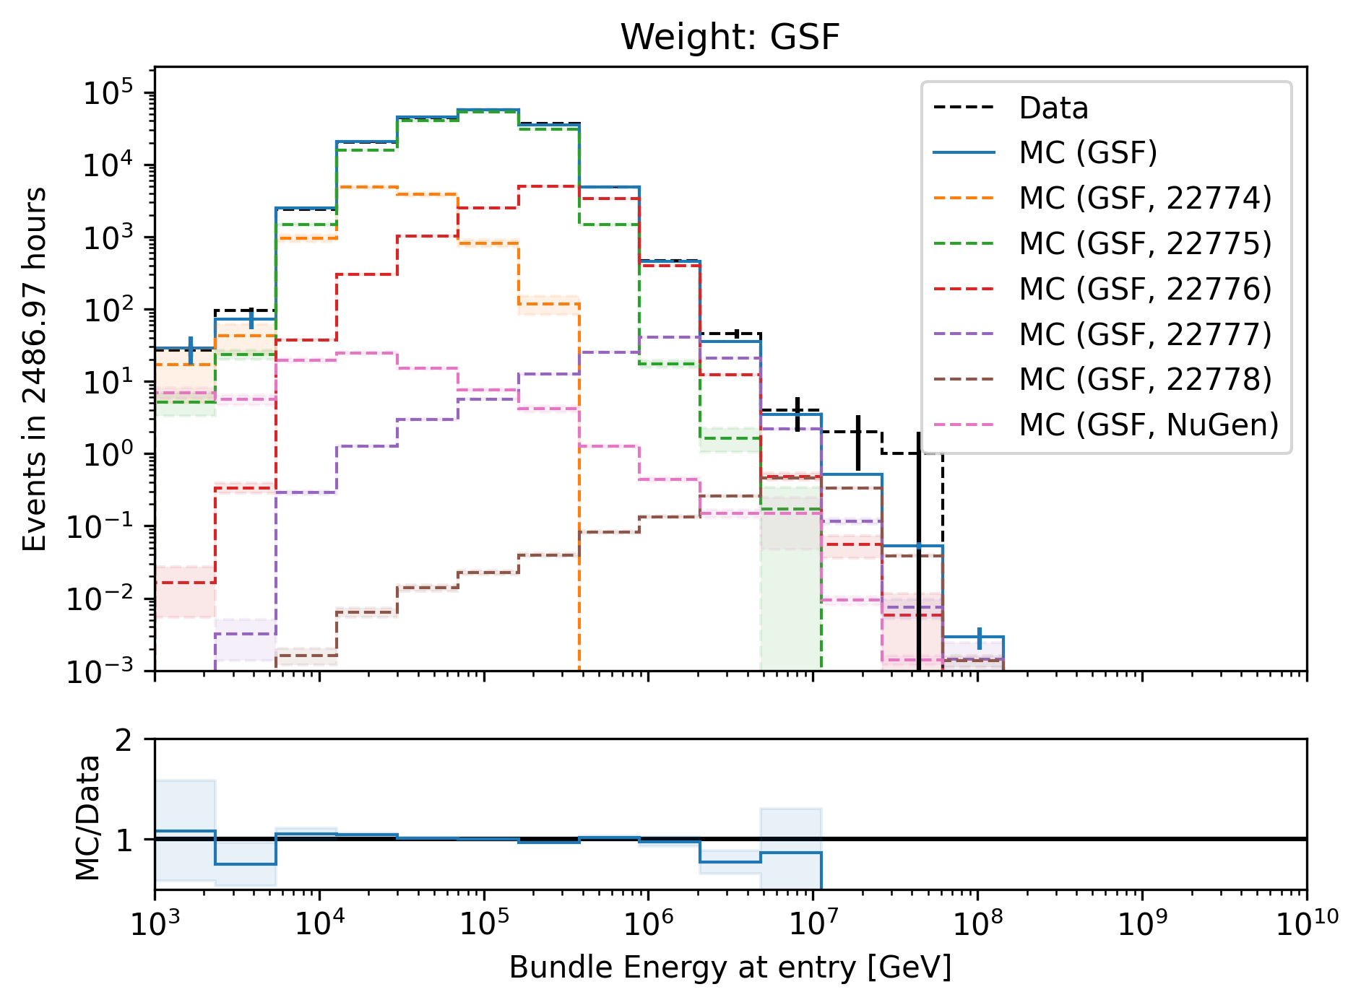
Bundle energy at entry

Slide 33
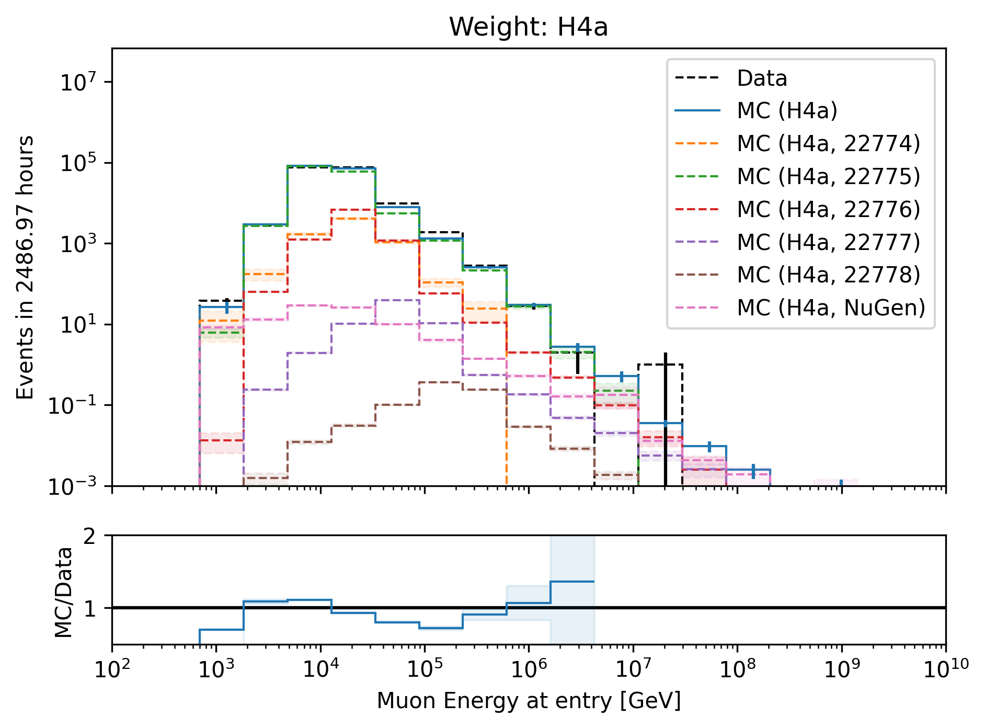
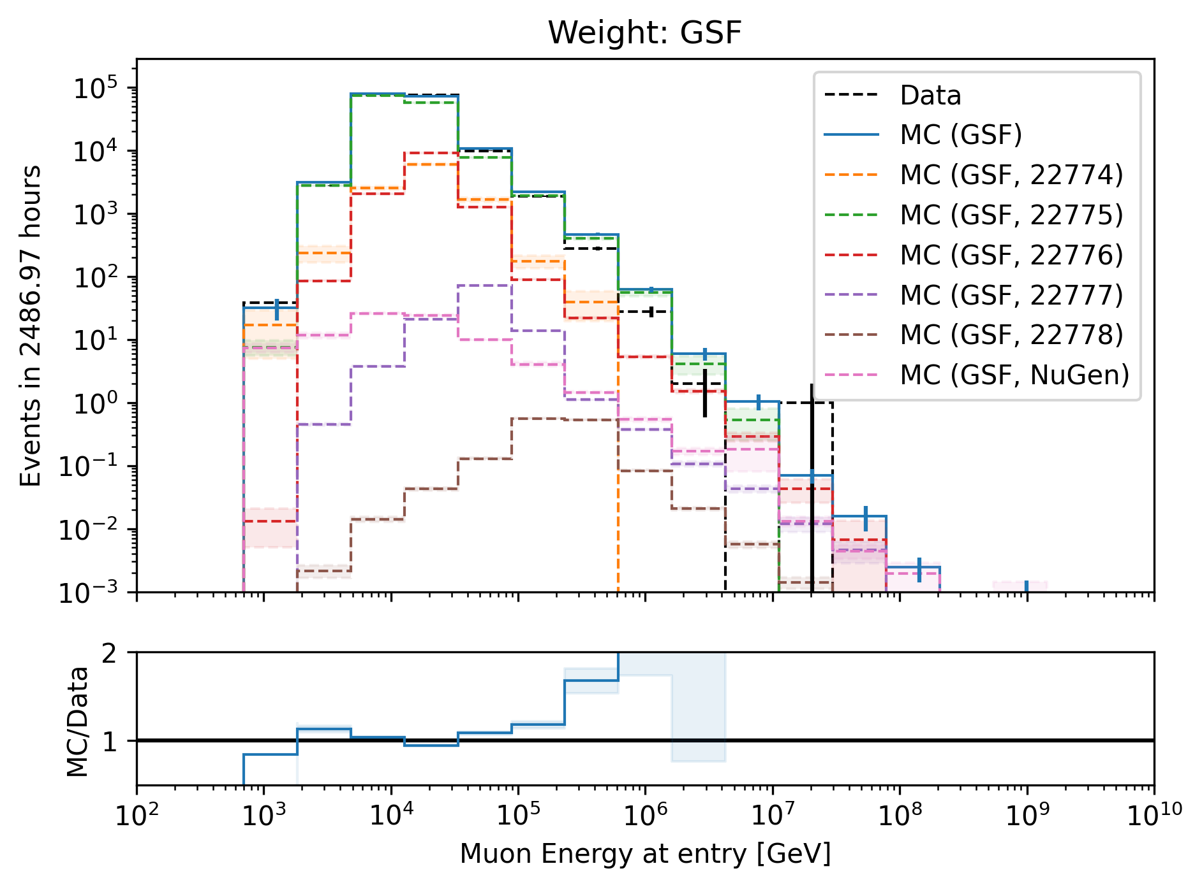
Leading muon energy at entry

Slide 34
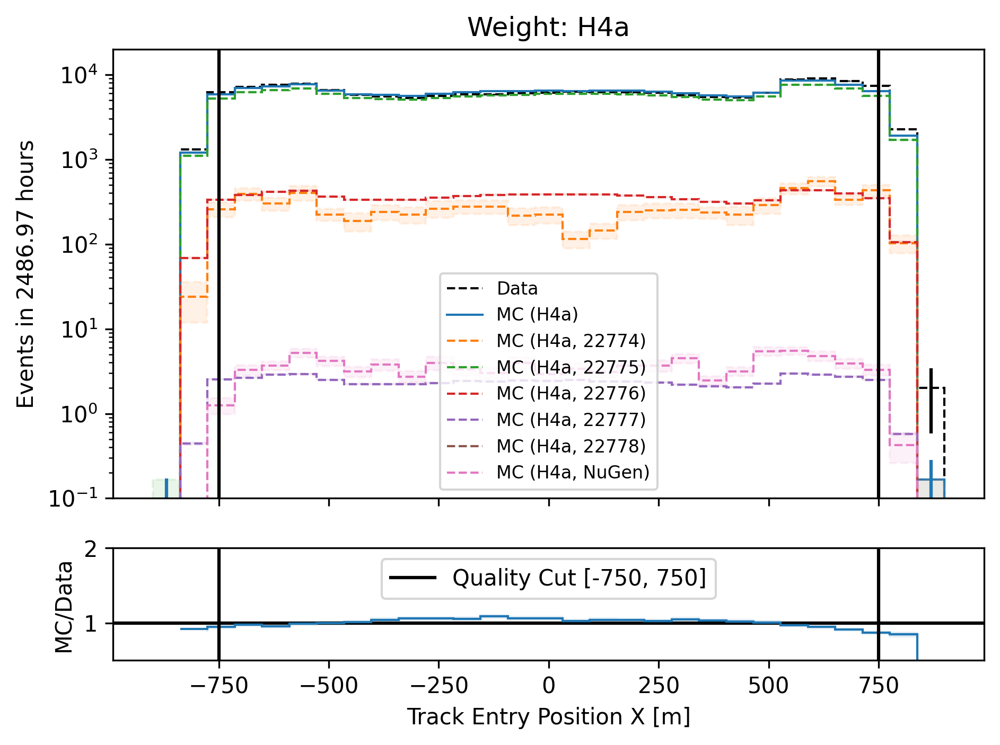
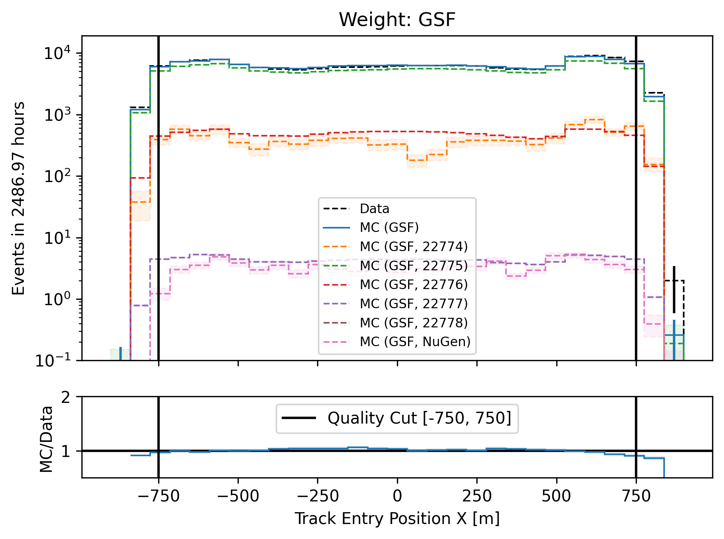
Entry position x–vertex

Slide 35
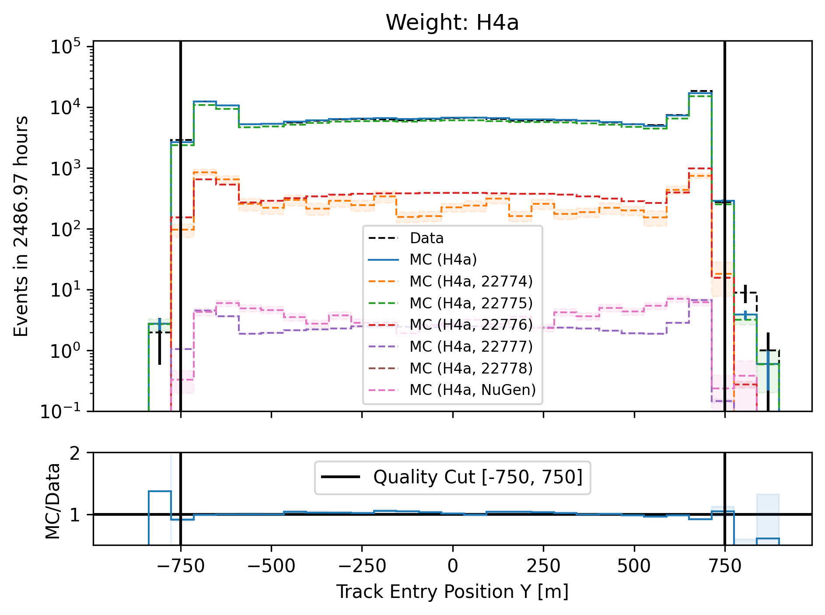
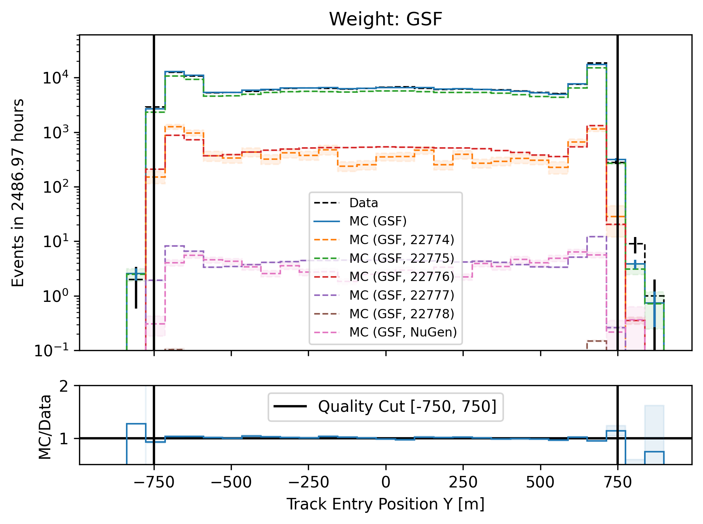
Entry position y–vertex

Slide 36
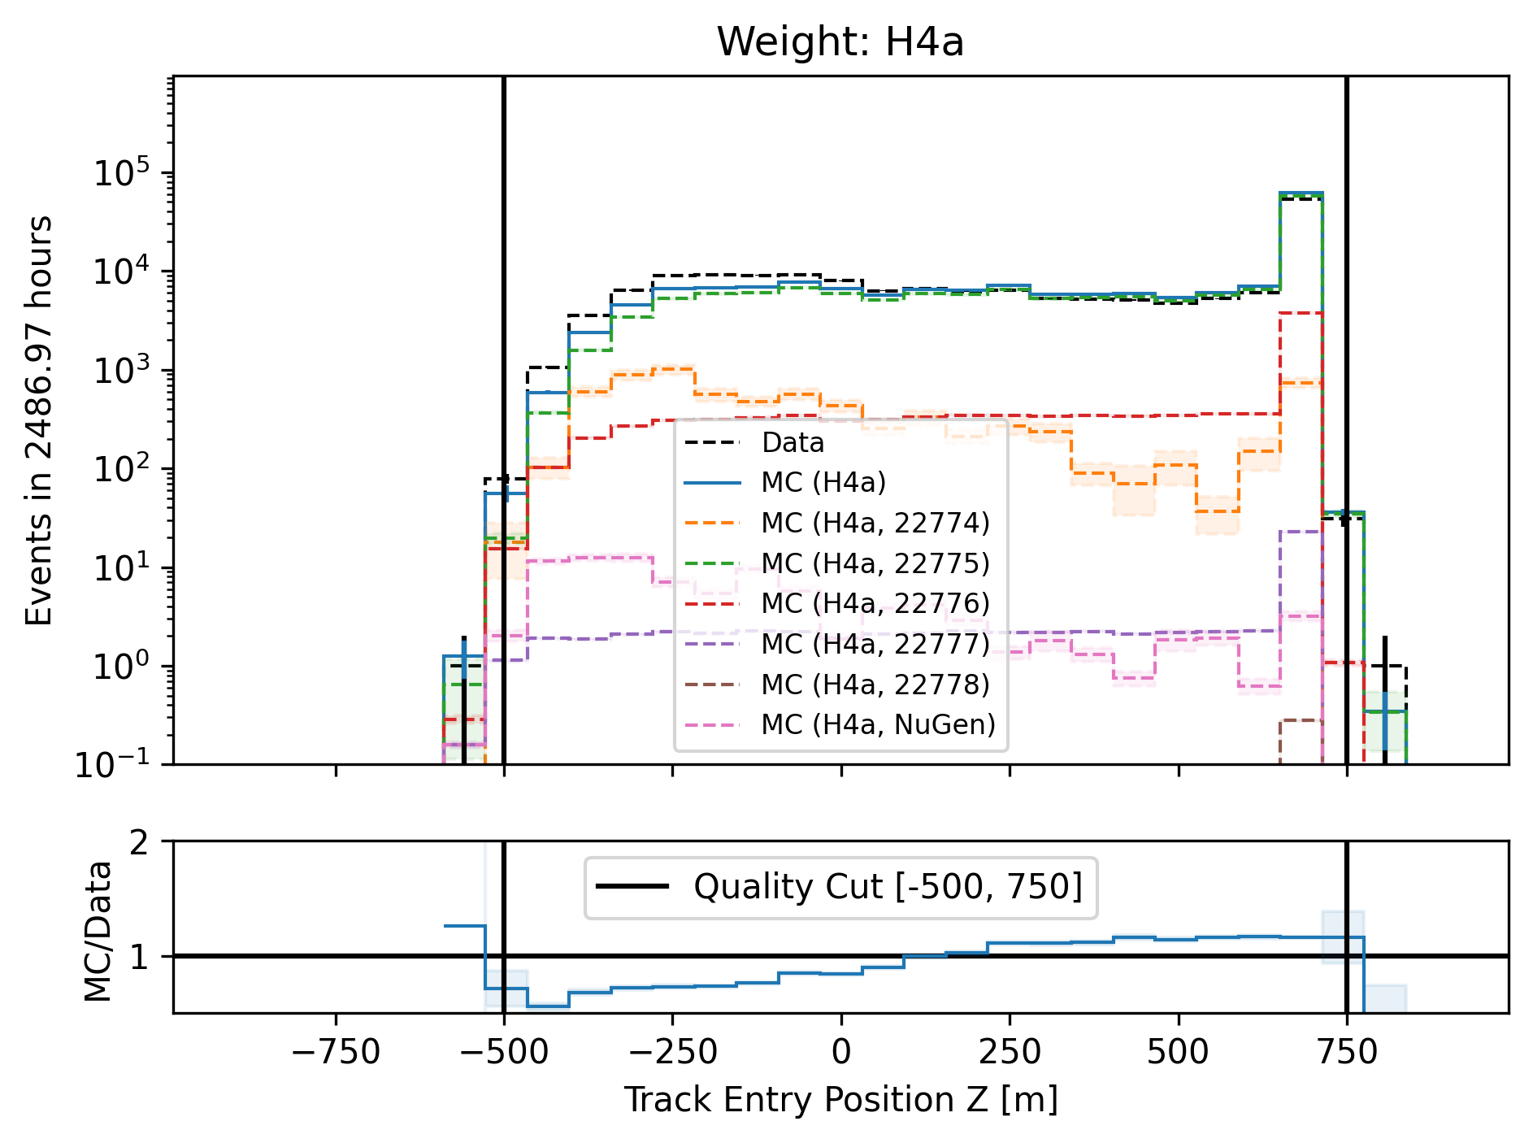
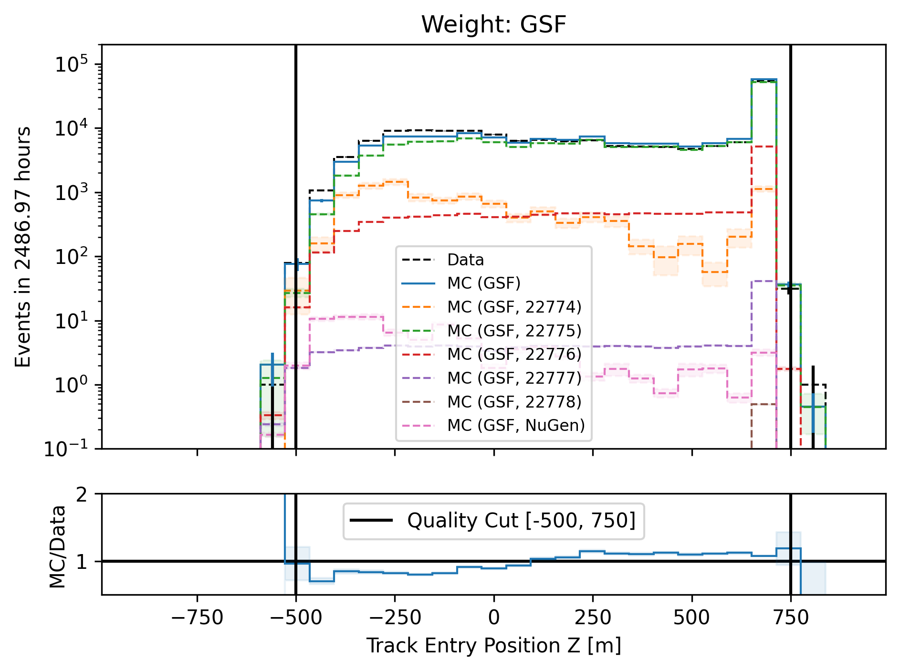
Entry position z—vertex

Slide 37
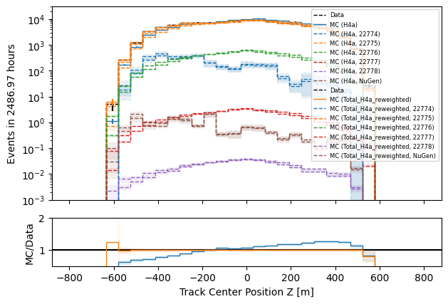
z—reweighting
re-weight events to enforce a perfect agreement in the center z—position

Slide 38
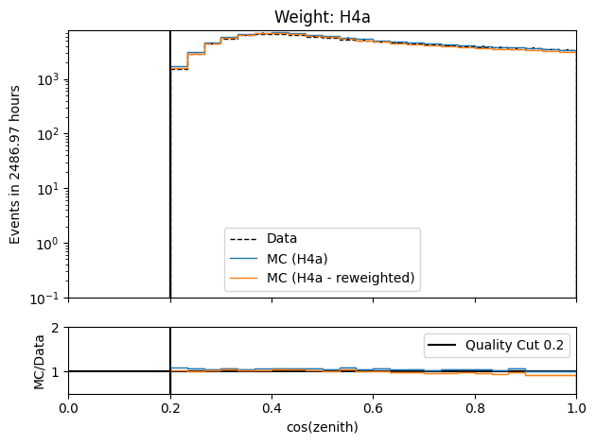
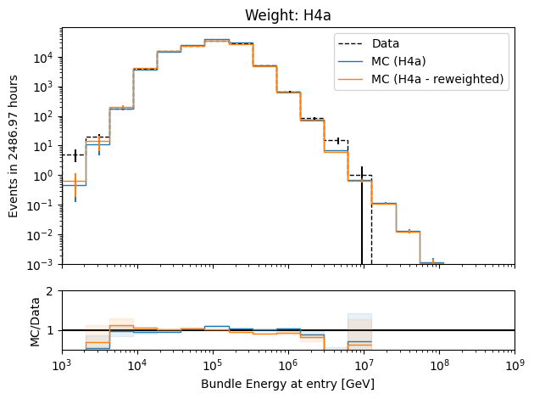
Check z—reweighting
re-weighting has no large effect on cos(zenith) and energy

Slide 39
Level5: quality cuts
containment cuts | > | <
length in detector | 1000 m | 2000 m
entry pos x, y | -750 m | 750 m
entry pos z | -500 m | 750 m
center pos x, y | -550 m | 550 m
center pos z | -650 m | 650 m
uncertainty cuts | <
bundle energy at entry | 0.9 log10(GeV)
bundle energy at surface | 2.0 log10(GeV)
zenith | 0.1 rad
azimuth | 0.2 rad
entry pos x , y, z | 42 m
center pos x, y, z | 50 m
entry pos time | 200 ns
center pos time | 600 ns
length in detector | 160 m
length | 2000 m
neutrino cuts | > | <
cos(zenith) | 0.2
length | 5000 m | 15000 m

Slide 40
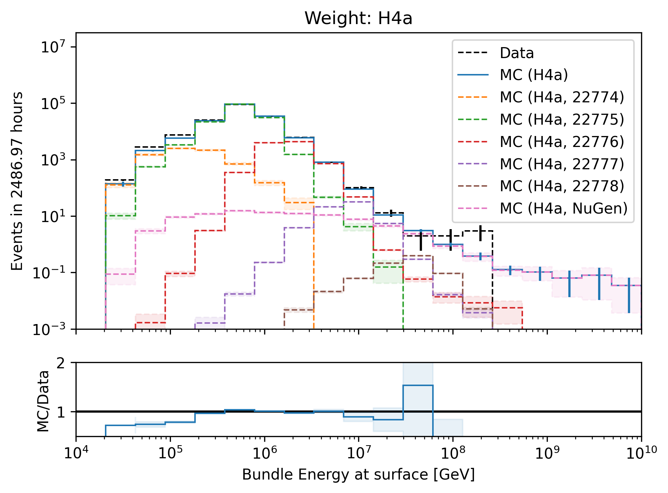
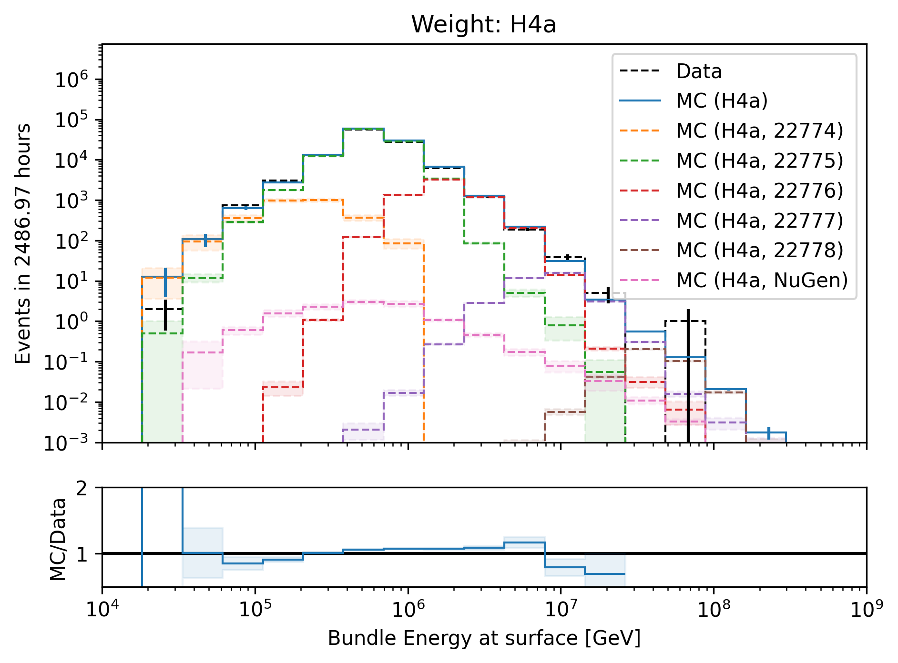
Level5: quality cuts → removes neutrinos
network learns: a high-energetic horizontal event in the detector needs a very high energy at surface

Slide 41
Forward fit

Slide 42
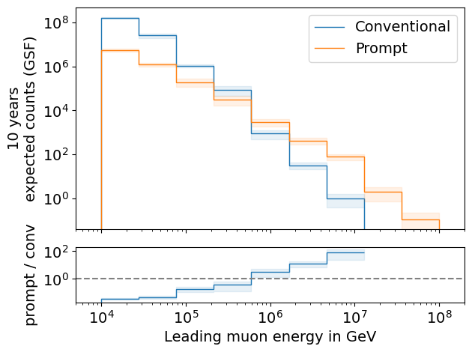
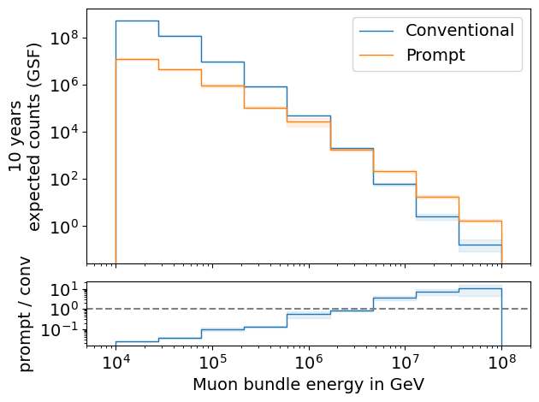
Expected muons for 10 years: leading vs. bundle energy (GSF)
leading: energy of most energetic muon in a muon bundle
bundle: sum of energies of all muons of the bundle
L2 MuonFilter
L2 MuonFilter
Both leading and bundle energy are sensitive to detect prompt
Leading muon energy is more sensitive

Slide 43
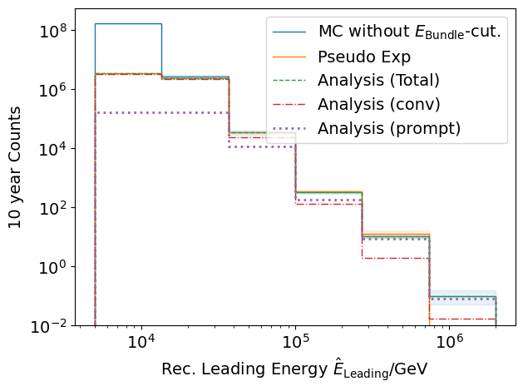
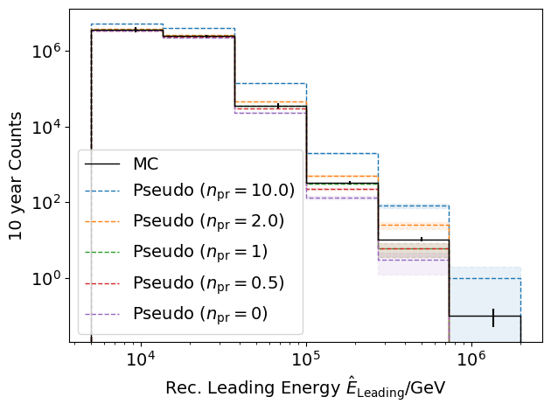
Pseudo data sampling
Cuts:
L2 MuonFilter
Bundle energy at entry > 100 TeV
Tagging allows scaling of prompt by factor n_{pr}

Slide 44
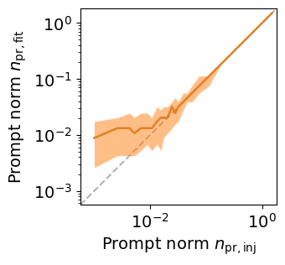
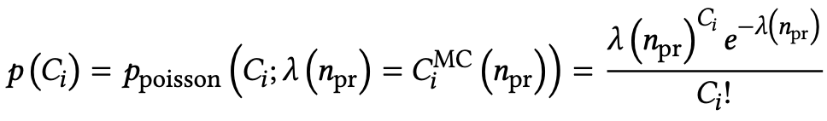
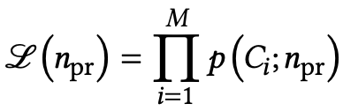


Poisson likelihood fit performed in leading muon energy
Cuts:
L2 MuonFilter
Bundle energy at entry > 100 TeV
Test bias
Prompt scaling/normalization
MC counts per bin i
Conv norm = 1
Experimental counts
Maximize likelihood
With a constant conv norm:
bin counts depend only on prompt norm
= expectation value per bin
Easier:
minimize negative
log-likelihood
Test statistic for Wilks’ theorem
Bias starts at a prompt normalization of ~0.1
Null hypothesis: no prompt

Slide 45

Discovery potential and sensitivity
Cuts:
L2 MuonFilter
Bundle energy at entry > 100 TeV
Expectation for 1 year:
5 sigma discovery potential: 0.102 ± 0.005
Sensitivity: 0.024 ± 0.001
Expectation for 10 years:
5 sigma discovery potential: 0.032 ± 0.001
Sensitivity: 0.007 ± 0.000
Caution:
Limited MC statistics -> events are oversampled in pseudo dataset
No systematic uncertainties

Slide 46
Unfolding

Slide 47









Unfolding in a nutshell
folding
unfolding
1. discretized form: $\vec{g}=A\vec{f}↔\vec{f}=A^{−1}\vec{g}$
measured proxy
detector response
background
$$g\left(y\right)= \int_{E0}^{E1}{A\left(Eµ , y\right)f\left(Eµ\right) dEµ+b\left(y\right) }$$
2. maximum likelihod method:
$$ℒ\left(\vec{g} | \vec{f}\right)=\prod_{j=1}^{M}{\frac{λ_{j}^{g_{j}}}{g_{j}!}exp⁡(−λ_{j})}$$
3. Thikonov regularization:
$$t\left(\vec{f}\right)=−\frac{1}{2}{\left(C\vec{f}\right)}^{T}{\left(τ1\right)}^{−1}(C\vec{f})$$
true energy distribution
$$=\prod_{j=1}^{M}{\frac{{(A\vec{f})}_{j}^{g_{j}}}{g_{j}!}exp⁡(−{(A\vec{f})}_{j})}$$
funfolding
by M. Börner
4. maximize $log⁡(ℒ\left(\vec{g} | \vec{f}\right))+t\left(\vec{f}\right)$
with respect to $\vec{f}$ using
Markov Chain Monte Carlo (MCMC)
or Minuit
Credit: T. Hoinka

Slide 48


Proxy vs. target
1 year
10 years

Slide 49


Unfolding event rate
1 year
10 years

Slide 50


unfolding of muon flux at surface
1 year
10 years

Slide 51


unfolding of muon flux at surface – weighted to E^{3.7}
1 year
10 years

Slide 52

Conclusion & outlook
New CORSIKA simulations with parent information
tag prompt and conventional muons
validation: agreement with MCEq
Add DNN-based reconstructions
Good data-MC agreement
quality cuts defined
good agreement in cos(zenith) distributions
mismatch in z—position → re-weight distributions
Fit of prompt normalization is promising
systematics need to be included
Unfolding is set up
systematics can be included, minor investigations needed
How ChatGPT illustrates the detection of a prompt muon with IceCube.
Thank you for your attention!

Slide 53
Backup

Slide 54

Leading muon energy fraction
Solid: conventional
Dashed: prompt
Prompt dominates for energies > 1 PeV
Leading energy sweet spot: 0.1 – 0.9

Slide 55


Leading muon contribution
Patrick Berghaus
Muons with energies between 100 TeV and 50 PeV dominate the bundle by more than 90%
In average conventional muons are more dominant than prompt
But: at high energies, there are more prompt than conventional events
High leading energy fraction does not lead to more sensitivity to detect prompt

Slide 56

The Muon Puzzle
”muon number”
2108.08341

Slide 57

Possible Solutions
Hans Dembinski

Slide 58

Simulation w/o coincident events
for primary energies above 1 TeV, using a time window of 6 µs, the chance for a coincident event is ≤ 1 %

Slide 59
Bundle energy cut
Rate after muon filter: 24.62 Hz
If the process of 1 event needs 1 second, 8h run takes 200h -> needs to be reduced!
Use small, fast network to remove low energy events -> target rate 125 mHz
CPU runtime: 11 ± 1ms
GPU
Network: precut_surface_bundle_energy_3inputs_6ms_01

Slide 60
Leading muon energy fraction - leadingness
True muon energy fraction is smeared
Network tries to predict the median of the distribution

Slide 61
Zenith – 6 ms cleaned pulses
Median + 90% quantile
Prediction
True

Slide 62
Azimuth – 6 ms cleaned pulses
Median + 90% quantile
Prediction
True

Slide 63
SplineMPE – DNN and conventional seeds
SplitInIceDSTPulsesTWCleaning6000ns

Slide 64
SplineMPE – DNN seeds
SplitInIceDSTPulsesTWCleaning6000ns
DNN contours

Slide 65


Level5: cos(zenith)

Slide 66


Proxy and target variable for unfolding – 10 years [H4a]

Slide 67

Unfolding with prompt and conv MCEq

Slide 68


Prompt and conv: muon energy at surface for 10 years

Slide 69


Compare all primary fluxes

Slide 70


Rates per month
before quality cuts
after quality cuts

Slide 71

Rates per month: scaled

